Slide 1
R from the VeRy Beginning - Introduction
Joe Cursio (jcursio@ben.edu and jcursio@stuart.iit.edu)
DuPage R Users Group
October 23, 2018 (Lisle, IL)
Notes:
Sorry about the capital R in the word very.
This has become an inside joke among the organizers of the Chicago R Users Group,
And I could not resist.
I didn’t spell it that way on the meetup website – because I didn’t want people to know how nerdy I am.
But I’m pretty sure you all realize by now, there’s no point in me attempting to hide it.

Slide 2

A Word from Our Sponsors
from Travis Linderman "Please mention that on November 16th (3PM) that Innovation DuPage will be sponsoring a Tech Founders Panel at Benedictine featuring four venture-backed female founders and that will lead into the Analytics Hackathon. You can also mention that the Innovation DuPage Headquarters (IDHQ) will be opening to tech startups, developers and entrepreneurs in April of 2019 and they can reach me directly to learn more or to meet in person at ID@cod.edu."

Slide 3
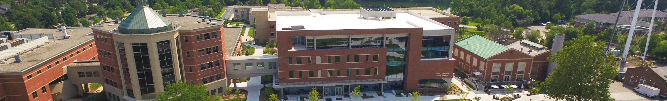
A Word from Our Sponsors
Benedictine University offers classes.
Talk to me
See www.ben.edu for more information

Slide 4
At Any Time, Feel Free To ___
Interrupt me and ask questions
Have me repeat something and/or slow down
Have someone see what’s on your laptop
Talk with other people
…

Slide 5
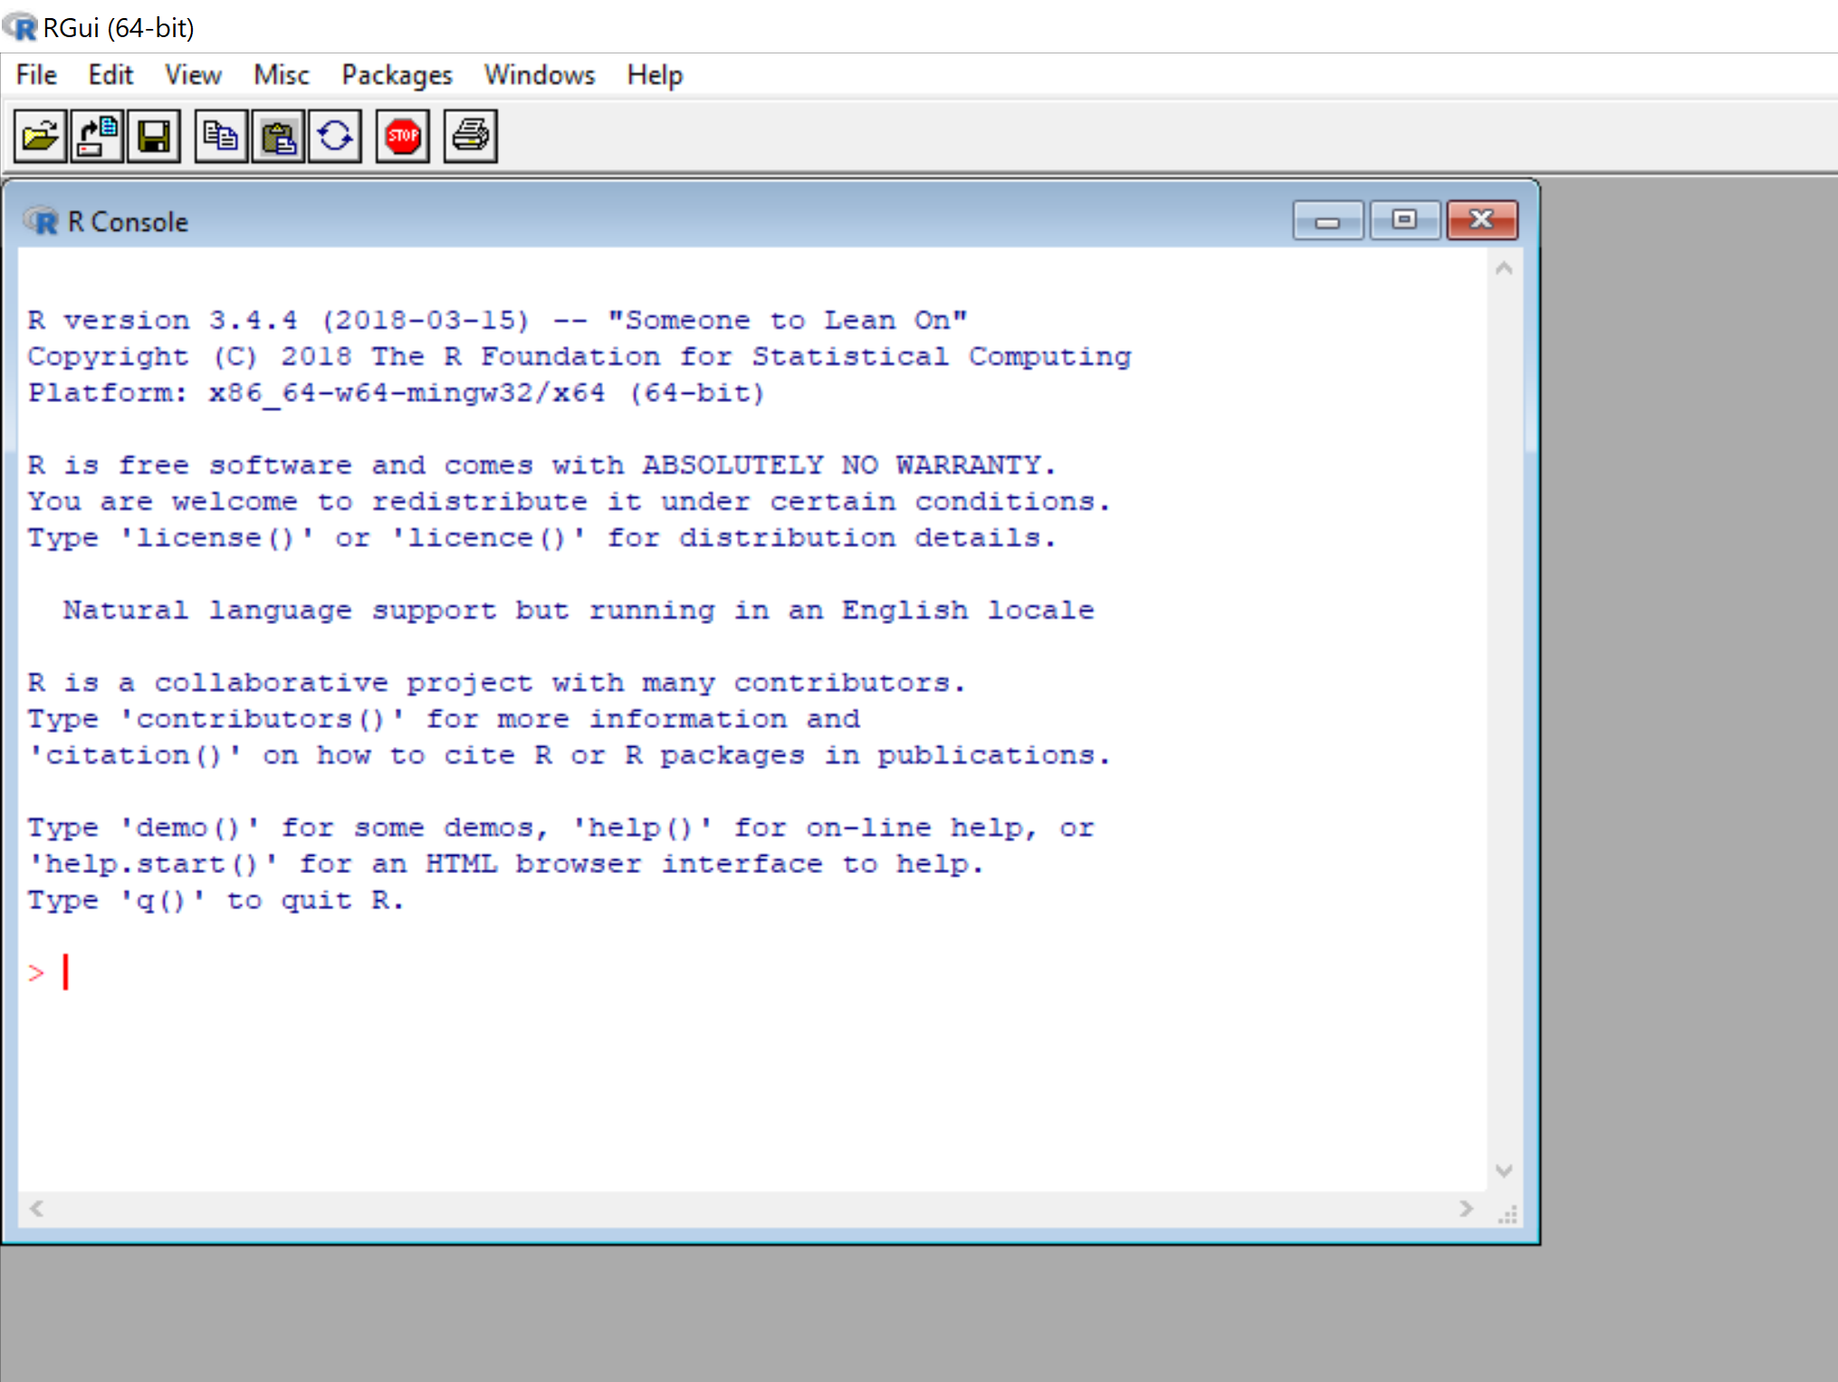
“R GUI”
The free documentation that comes from “CRAN” assumes you will use this interface.
And some other books/PDFs/Videos assume this as well.
But there is a better one: the free and open source “RStudio.”
I hope both of these are multi-platform
Notes:
For the next few minutes I’m going to use the default user interface that comes with R.
This is OK, but there’s a much better one I’m going to show off later. I’m mainly showing this off right now
Because some documentation and videos use this interface.
Normally, I would skip to the clearly better version.

Slide 6
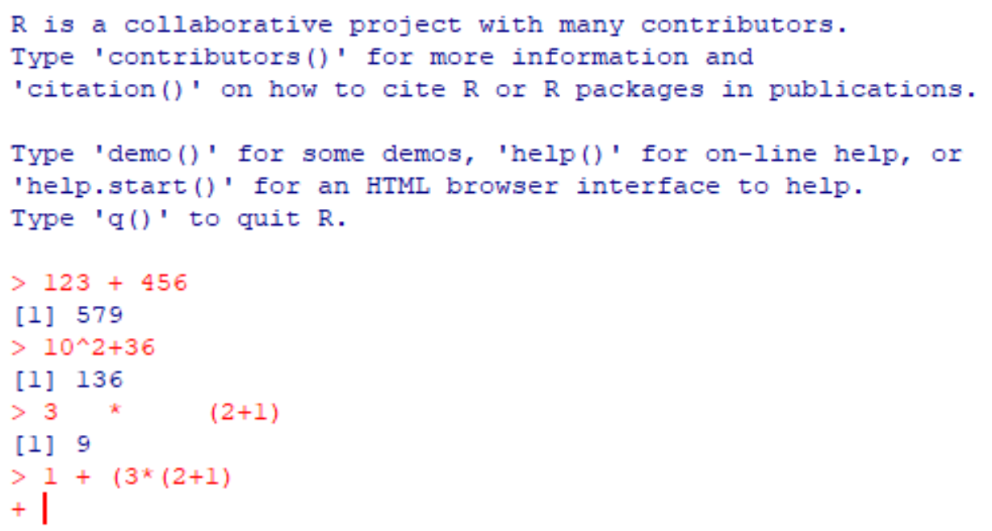
You Can Use R as a Calculator
R does not care about spaces between the symbols.
No spaces at all
Single space
Multiple spaces
R recognizes when you are not finished
We need a right parenthesis to finish the last equation
Notes:
We can use R as a calculator. For example:
123 + 456
10^2 + 36
3 * (2 + 1) # R only likes parentheses, we cannot use square brackets or curly brackets
1 + (3 *(2+1) # oops we forgot a closing parentheses – R will show us it is expecting something
Also note, unlike Excel, R is ok with having one or more spaces separating the symbols.
Obviously you cannot separate the digits within a number, but its up to you if you want extra spaces between the symbols.
Yes, I admit this is not very exciting – but I don’t want you to be alarmed when you see a “+” rather than a result.

Slide 7
I Don’t Make Misteaks
At certain points, I will deliberately make mistakes just to show how R reacts and how easy it is to correct
Other times, I’ll make mistakes by talking and typing at the same time
Sometimes I’ll make mistakes due to bad habits (learned from other programming languages)
So to protect my sensitive ego, assume all mistakes are intentional
Notes:
I’m kinda assuming from the last example that we probably did not intend to miss the final right parenthesis.
I did this deliberately to show one of the things that could happen when what you actually did was not 100% of what you thought you did.
Computers are very literal-minded and don’t have any kind of “you know what I mean” type of understanding that a person would have.
But I don’t want you to freak about this – as long as we can figure out why the computer doesn’t do what we want it to,
Any mistakes are easy to fix. Well, usually…but I don’t want to scare people.
Sometimes hitting the <escape> key or <cntl><c> (holding down the control key and hitting C, will help if you’re stuck for some reason.

Slide 8
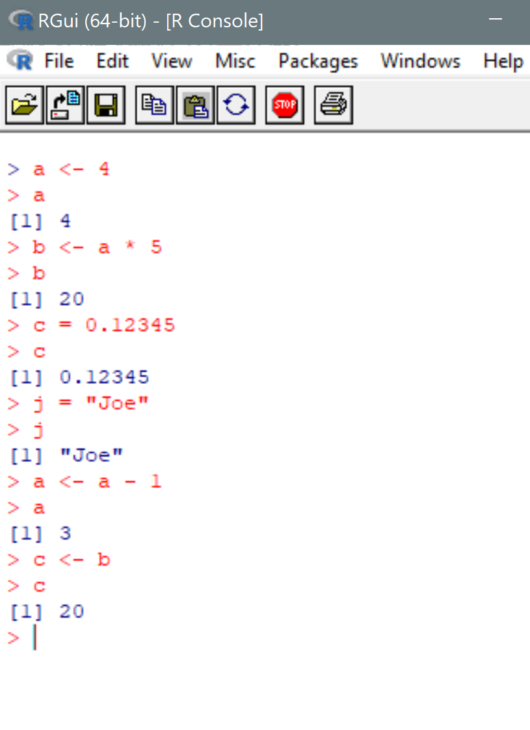
Assigning and Using Variables
You can save results to be used later. These locations you can save to are called “variables” because they can be changed (again, and again).
Values can be integers (whole numbers), real numbers (with decimal points), characters of text, and more
To see what value a variable has, just type in the variable. Or type in print(<variable>)
Notes:
You can also save the results of calculations and operations. But to refer to some result later, we need to give it a name. Here are some examples.
a <- 4
a
b <- a * 5
b
c = 0.123
c
You can reassign a new value
a <- a + 1
a
c <- b

Slide 9
Helpful Hints on Assigning Values
Use the “<-” instead of “=“ for assignment.
It normally does not make a difference, but there are some obscure technical reasons when “=“ does not work properly
The names we assign the results to are called “variables”
They don’t have to be a single letter.
Mathematicians, statisticians, and programmers like using short names.
You can make the name almost as long as you want.
You can use uppercase and lower case letters, digits, and two special characters “_” and “.” (as long as you start with a letter)
Notes:
Mathematicians and statisticians like using single letter names, “Let m be a matrix…” so a lot of tutorials use short names as well.
But there’s nothing longer with using a normal name if that makes sense to you.
And while I’m at this, a lot of old-school computer programmers like short names as well. It saves on typing.
We’ll see examples later of a function called just “c” for “concatenate” (or is it “combine”),
And another function of just two letters “ls” for list
And another function of just two letters “rm” for remove.
We’ll see the later two functions in action in a few slides.
The limit of the length is some very large number. You should run out of patience before the computer does.

Slide 10
About Naming - Conventions
Although an uppercase letter is different than a lowercase one, which makes “Apple” different than “apple,” most people don’t remember the distinction.
So do not make variables that differ only by upper vs lower case
Sometimes it is handy to have a name that consists of two words. For example, I would like to use “Joe Cursio” but the space makes this look like two different variables because it is two words. So instead…
Try “joeCursio” use uppercase letter to separate words called camel case
Try “joe_cursio” use an underscore to separate the words
Try “joe.cursio” use a dot to separate the words
Notes:
One thing about conventions is that there are so many of them. Different groups of people like/prefer one over the others,
And since there’s no wrong way, some people feel very strongly about the particular method they prefer.
Personally, I’m used to the first method because I used to program in C/C++/Java.
And in those languages the dot has a special meaning, so the third was looks unnatural to me.
How many people here program in those languages? Just about nobody? I thought so.
But that’s just me.
The standard convention most R people use is the “dot.”
My advice is to use the convention that everyone around you uses, and just nod politely when they say the other ways are wrong.
So this means I should learn to “play nice with others” and use the “dot” convention.

Slide 11
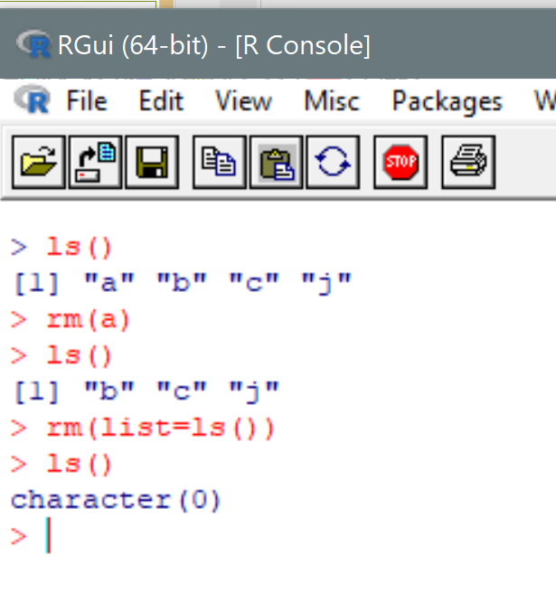
Seeing All Variables and Removing Them
The command to see what exists is called “ls()” if you notice it has parentheses because this is a command (or “function”) rather than a variable name.
The command to remove a variable is “rm(<variable>)
You can remove all variables by “rm(list=ls())”
You can nest commands – i.e. have one inside the other
The “list=“ is what’s called a “named parameter” and we’ll discuss this later
Notes:
Notice the conventional mathematician/statistician/programmer desire to have really short names:
Here’s a function called “ls” for list
And another function called “rm” for remove.
We’ll talk more about functions in a few slides. What’s nice about R, and just about any computing language,
Is that you can create and use your own functions – as if it belonged in the system right from the beginning.
Even better yet, if someone else makes their work available, then you can use functions that other people have created.

Slide 12
Scalars, Vectors, and Matrices
We can give a single name a collection of values all at once
Scalar – a single value: number(*) (0-dimensional array)
Vector – a series of all numbers(*) (1-dimensional array)
Matrix – a series of series of numbers(*) (2-dimensional array)
We can also name a list – a series of elements
Each element can be a number, or a character, or another list, and you can mix-n-match
(*) or a series of all characters, but I will not do that today.
Notes:
I have to admit that I’m a little lazy about distinguishing between lists and vectors, and I’ll occasionally say list when I mean vector and vice versa.
Also: these series can be other types that I have not told you about.
Sources: See page 3 of Torfs & Brauer

Slide 13
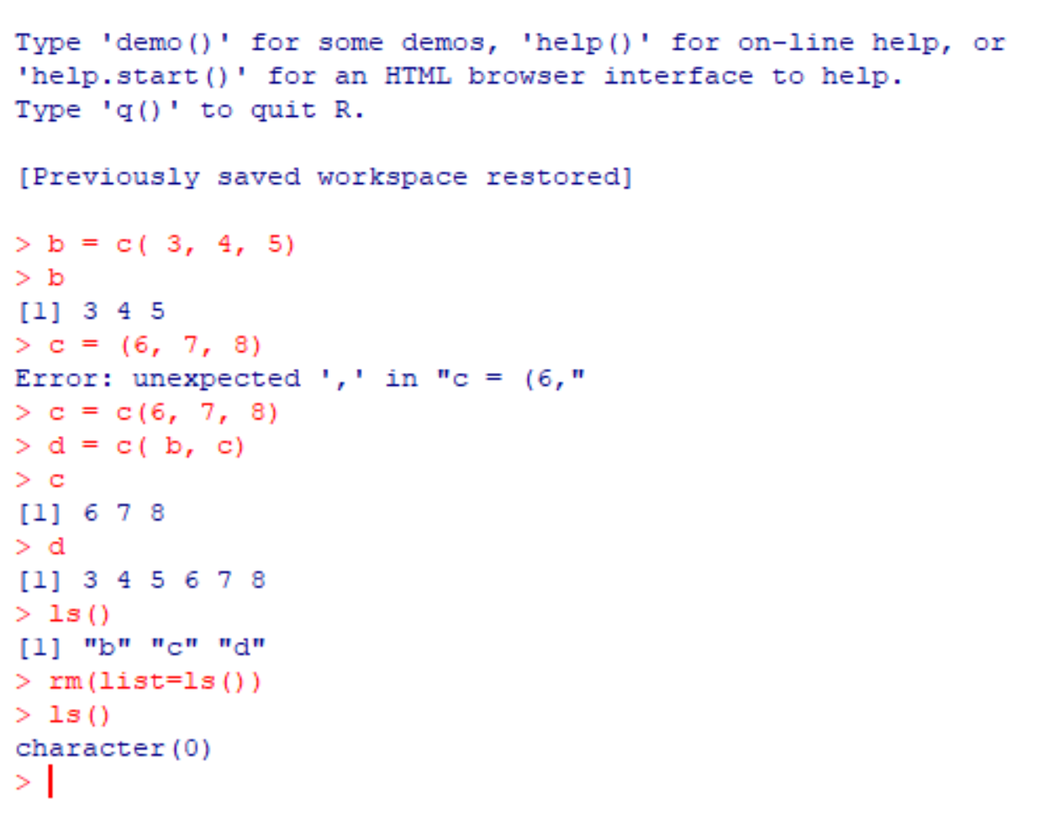
Creating a Vector
The function “c()” concatenates or “combines” values together into one list/vector.
If I use variables instead of specific values, then R will replace the variables with the values.
When I combined b and c together, it knows I want to combine the values of b and the values of c together.
Notes:
When I first wrote “c = (“ I forgot the “c” for “concatenate”

Slide 14
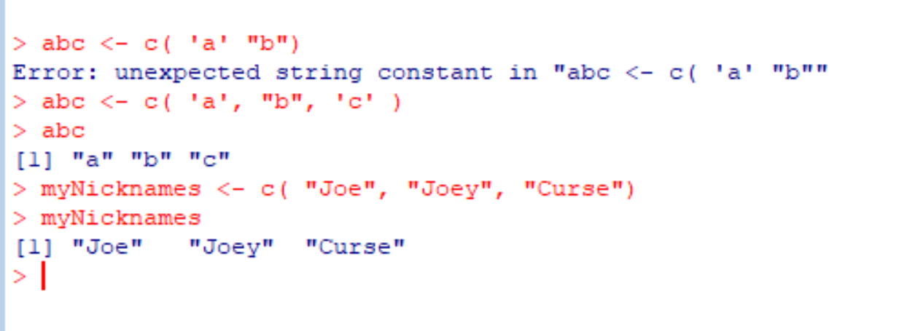
Variables Can be Strings of Letters
A series of letters and other characters that belong together is called a string.
You can define the start and end of a string by either a single quote or a double quote, but not one of each.
There are some tricks, but for now I just want to say we are not restricted to just using numbers.
Notes:
My personal recommendation is to use double-quotes whenever possible for consistency.
I’m deliberately using single-quotes some times, and double-quotes others.
The problem with mixing and matching is if I do it incorrectly, then I could be short a quote and not realize what I’m missing.
If you want a single-quote inside a string, then be sure to have double-quotes at the outside.
If you want a double-quote inside a string, then use single-quotes at the outside.
If you want both, then there’s some trickery.

Slide 15
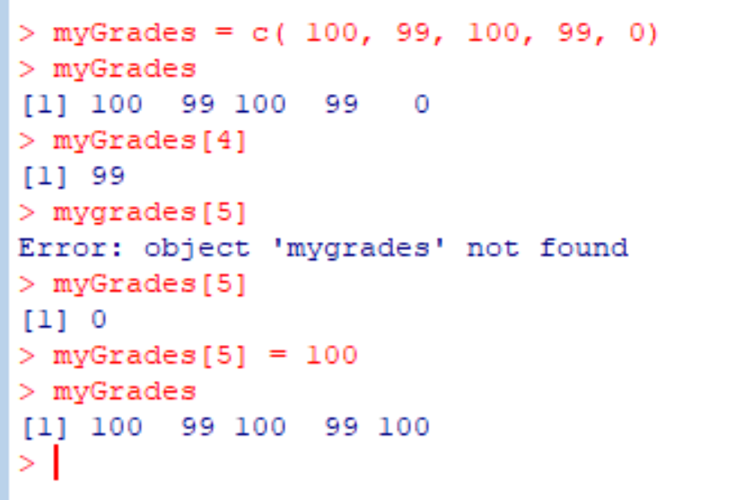
See and Modify an Element of a Vector
The number n inside the square brackets allow me to see the n’th element
I can change the n’th element to a different value
Notice a misspelling
Notice bad form using “=“ instead of “<-”
Notes:
Sources: See page 4 of Torfs & Brauer

Slide 16
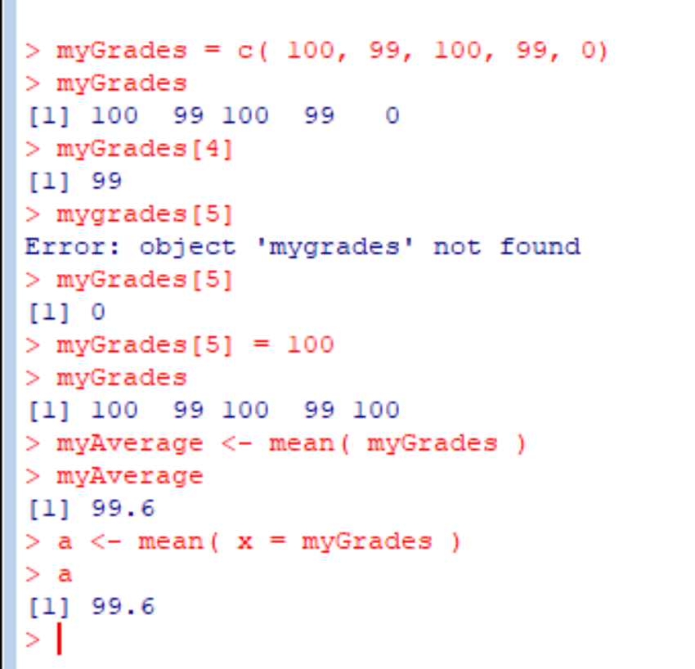
Functions
Here’s an example of using a function created for us. Like Excel, most functions have values inside parentheses called “parameters.”
There are many functions available to us “right out of the box.”
We can add packages (like Excel add-ins) to use many more functions. We’ll talk about packages towards the end of the session
Notes:
I’ll save matrices for later…

Slide 17
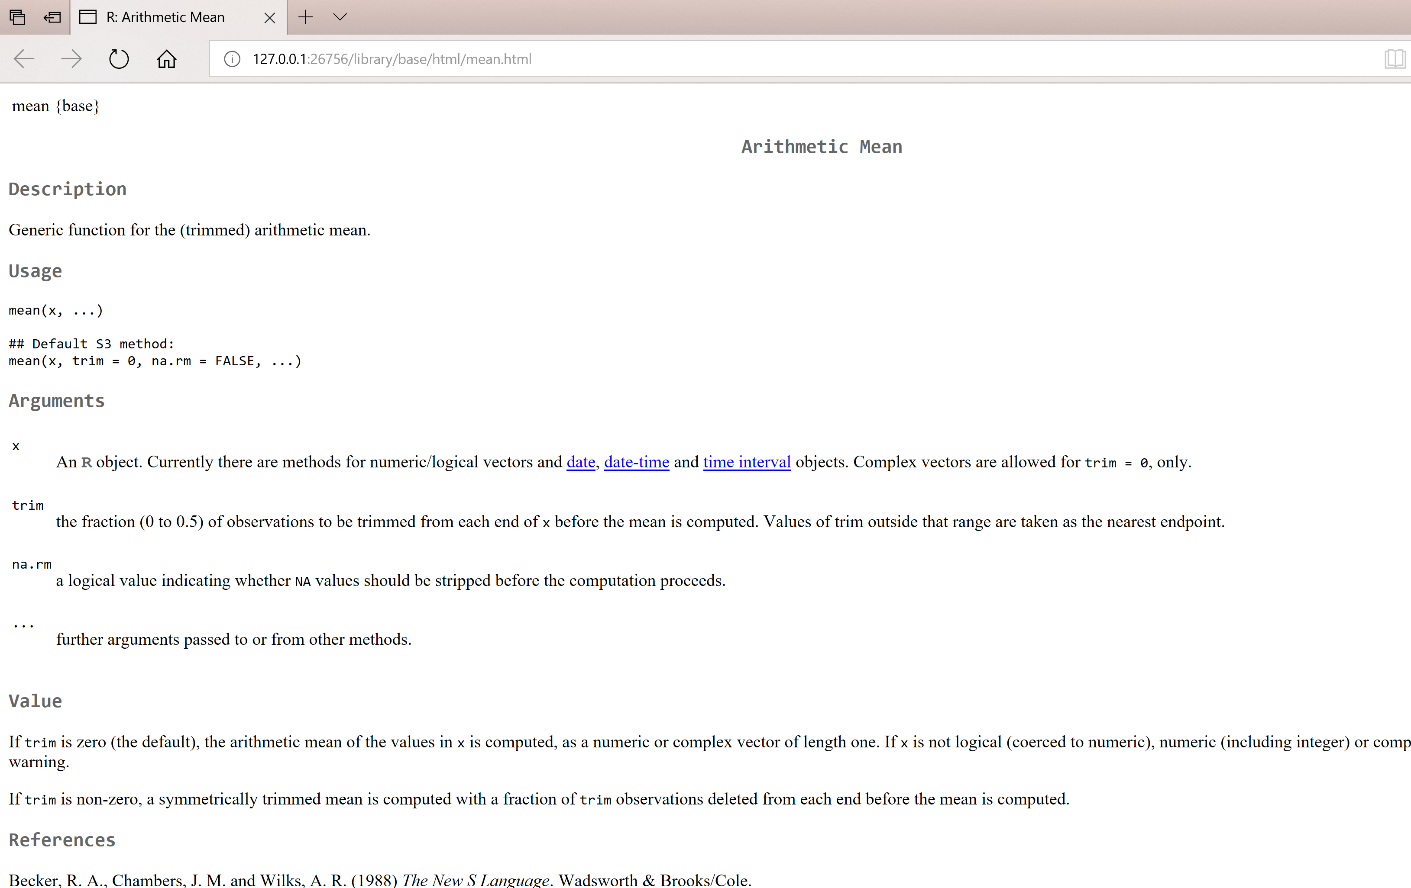
Help Me, Please
Typing help(“mean”) returned a web page
Typing help(“<topic>”) works when the topic has a name
Or you can try
help.search(“<topic>”),
args(“<function>”) or
example(“<function>”)
Shortcuts are ?(“<topic>”) and ??(“<topic>”)
Notes:
Typing help.(“help”) happens to be a good place to start. It tells you how you can better call for help.
If you want more focused help on a particular function or object, you can try:
args(“<function name>”)
example(“<function name>”)
If you want to go online within R: try RSiteSearch(“words or phrase”)
But at that point, I would also try Google or StackOverflow

Slide 18
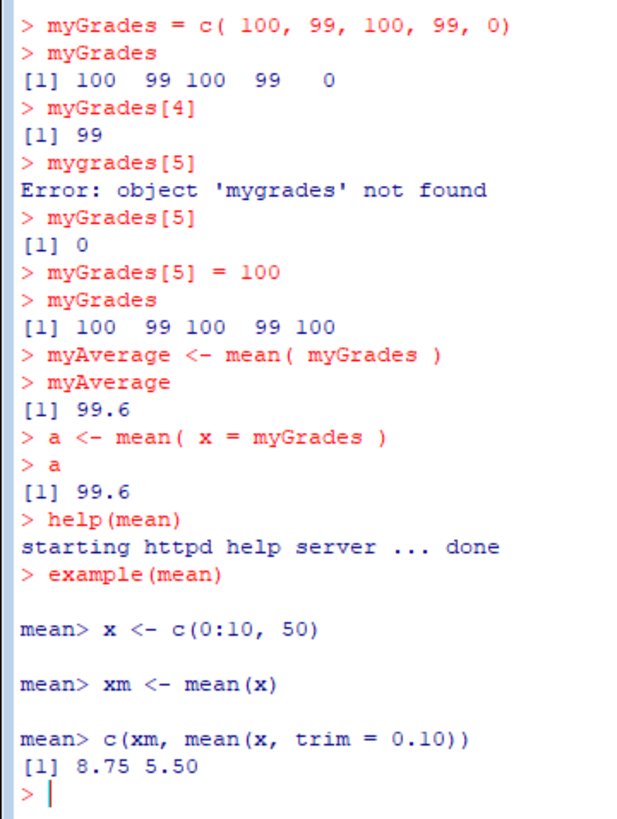
Help Via Examples
Typing “example(mean)” returned some examples of how to call the function.
Side note: the “0:10” means range and will give us numbers 0 through 10 inclusive.
Side note: the “trim=…” means I don’t know exactly. Maybe I should have read the help page when I had the chance.
Side note: we can place the results of a function into another function. In this case the result of the trimmed mean is concatenated with the regular mean.
Side note: sometimes we print a variable just by typing it. You can also type in print(myAverage)
Notes:
I’m not doing this today, just because it saves a bit of typing,
But I would normally say print(myAverage) on a line rather than just type myAverage,
just to remind myself what I actually wanted to print it,
as opposed to forgetting to do something else

Slide 19
Transitioning to RStudio
So by now you should be getting sick of moving from the command window, to help window and plot windows
Its also pretty tiresome to constantly check what variables exist.
There’s a better user interface that organizes all this stuff for us.

Slide 20
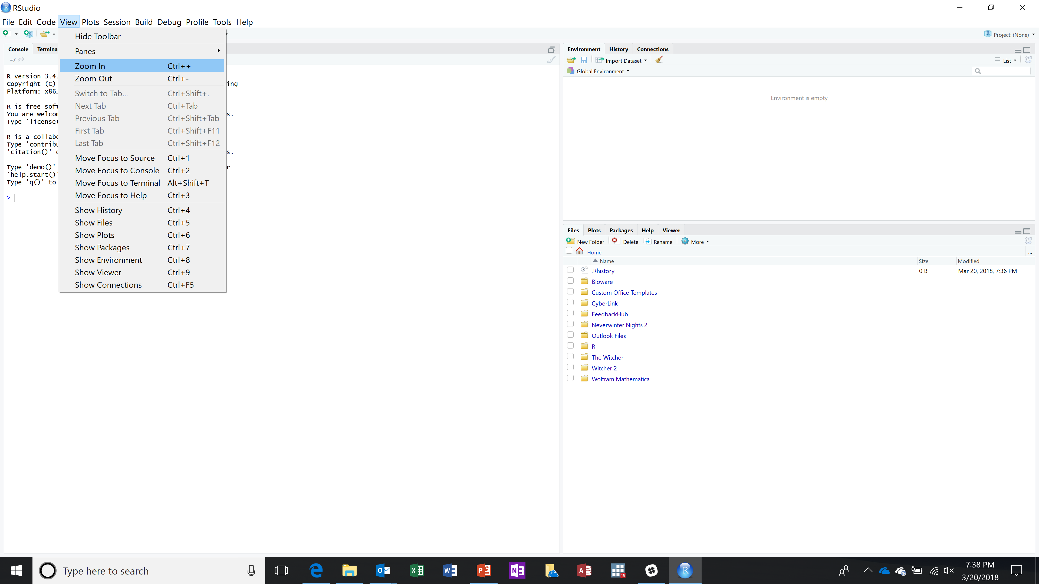
RStudio
Because I have a 4K monitor, everything is very small. Fortunately there’s a menu command that makes the text larger.
I needed to do this several times. This is the before…
Notes:
This better user interface has everything the RGUI interface has, but much more.

Slide 21
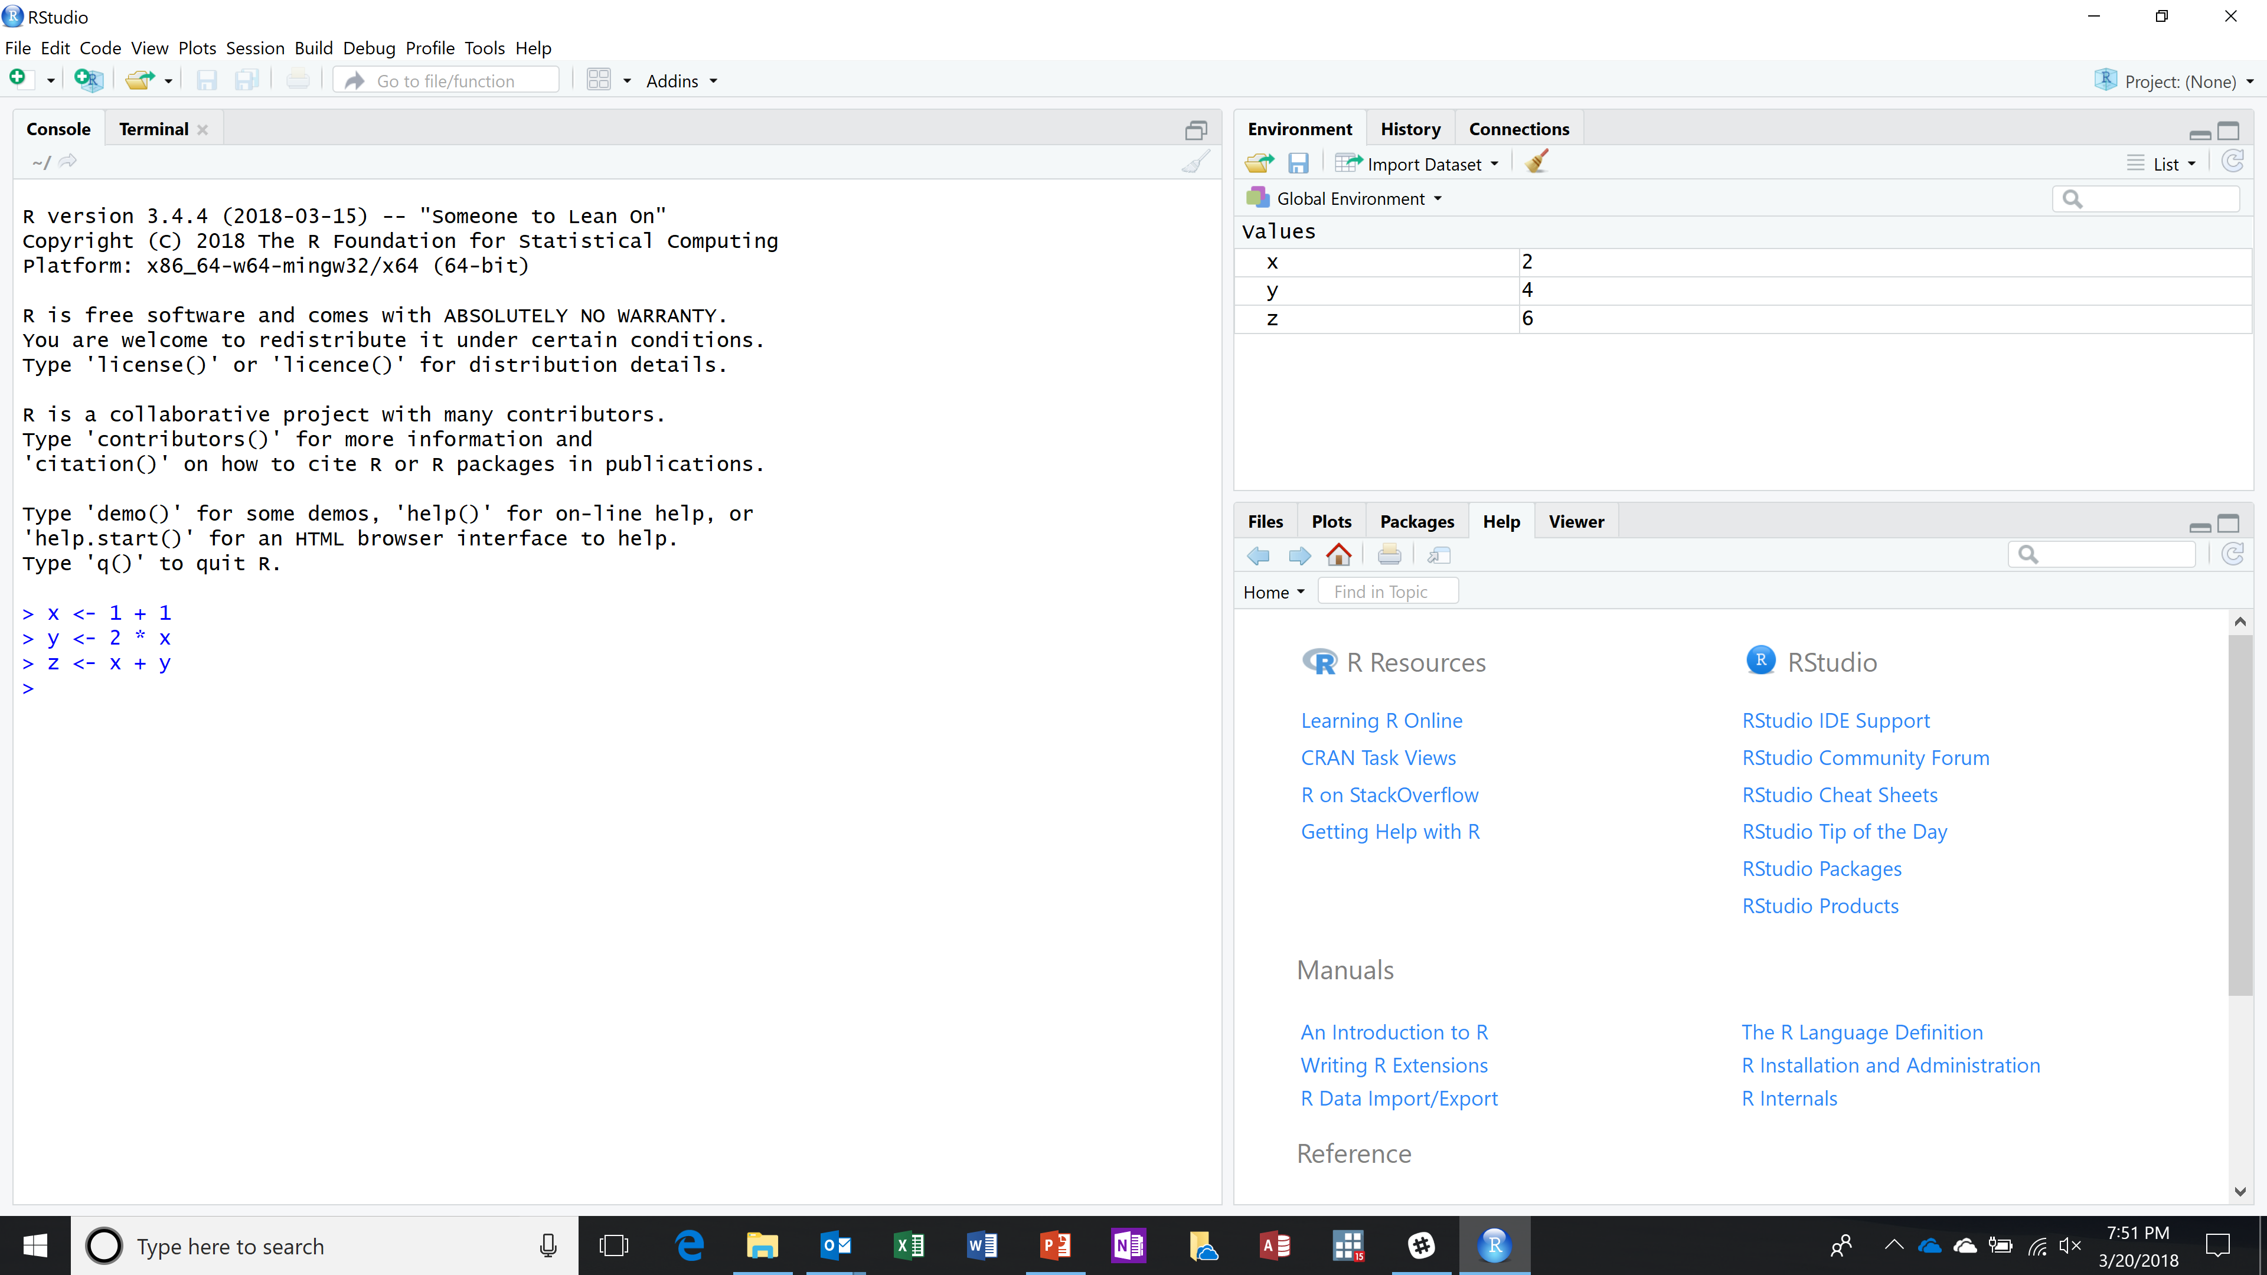
Notes:
The window on the left is called the “Console.” It looks pretty much like RGUI’s console from before.
We can type in commands after the “>” prompt, just like before.
You could switch the tab to look at the Terminal – but I won’t do that today.
It brings up the equivalent of you operating system’s dos prompt, or terminal in other OS’s

Slide 22
Notes:
The window at the top right is the “environment/history/connection” window.
It has three tabs, currently set to the environment.
The environment shows the objects I’ve created, so I do not have to list them all the time.
With this feature alone, this is already better than the older Rgui program we used before.
There’s also an “Import Dataset” button which is really handy. I’ll show that off later.
You can switch the tab to look at the History and Connection, but I won’t do that today.

Slide 23
Notes:
The window at the bottom right is the “Files/plots/packages/help/viewer” window.
I set the tab to “Help” which right now is providing the basic generic help for R.
You can switch the tab to look at Plots, which we will do later today,
And to look at Files, which we will do later today,
And more that we will not do later today.

Slide 24
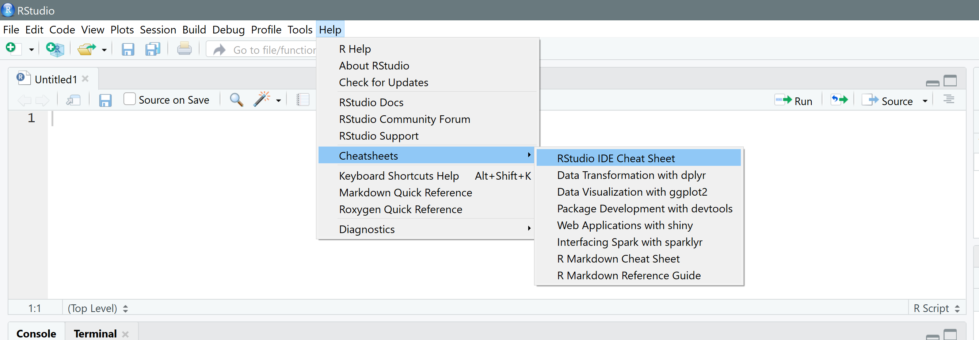
You Can Print a Cheat-Sheet

Slide 25
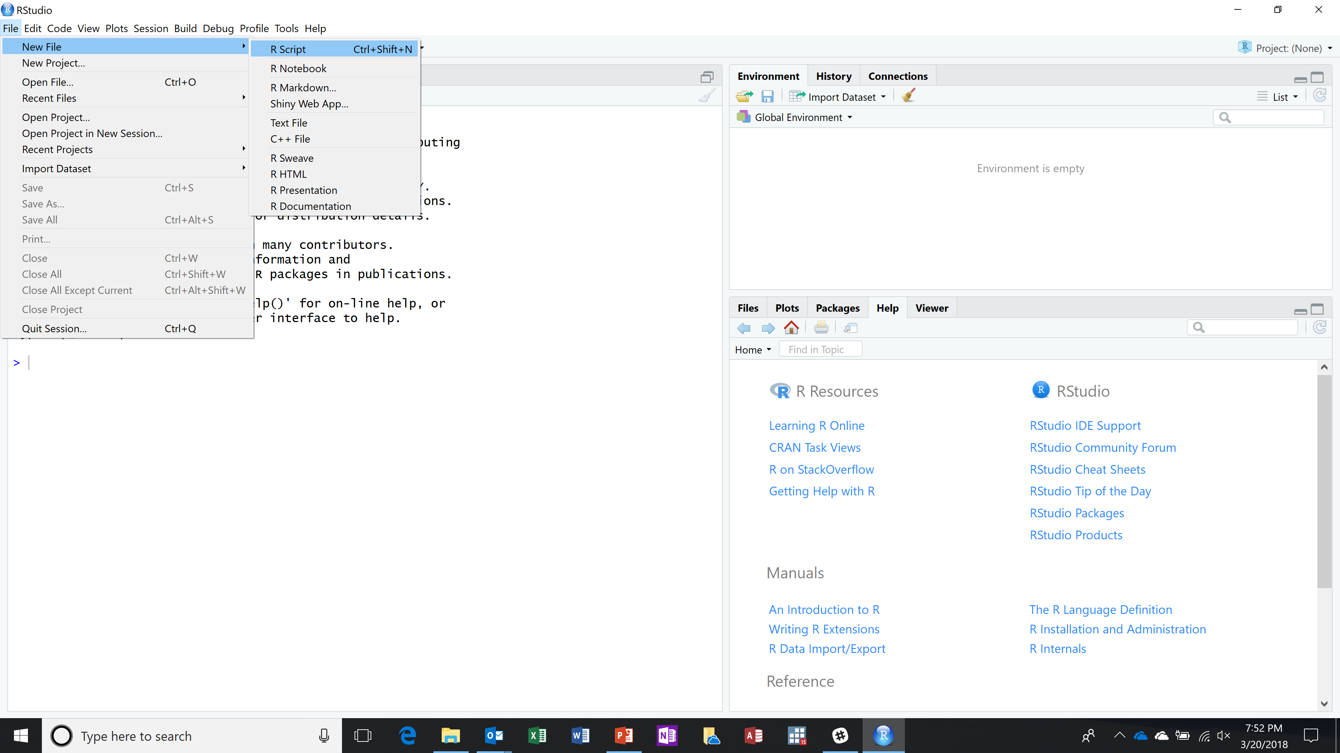
We can create a script window
Notes:
We can add another window called the “Editor” window.
This provides space for us to save and edit commands and scripts so that we can save and reuse them.
This is really nice because it allows us to save and later rerun work we otherwise do interactively.
The problem I have with interactive work is I always need to slightly revise something and try it again.
I always use a script window, even when I don’t have to, out of habit…

Slide 26
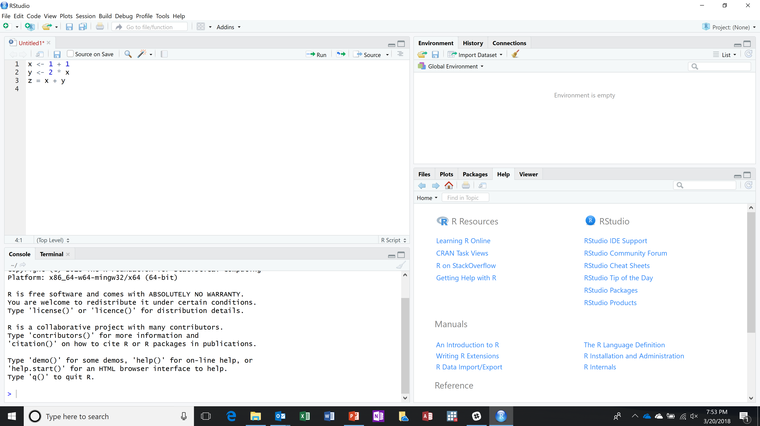
Notes:
Now the top left is the Editor window
We can type in whatever we want in the editor, but it does not automatically get run.
There are a number of ways we can run commands.
We can copy and paste from the editor to the console
We can highlight and click on the “run” button in the editor.

Slide 27
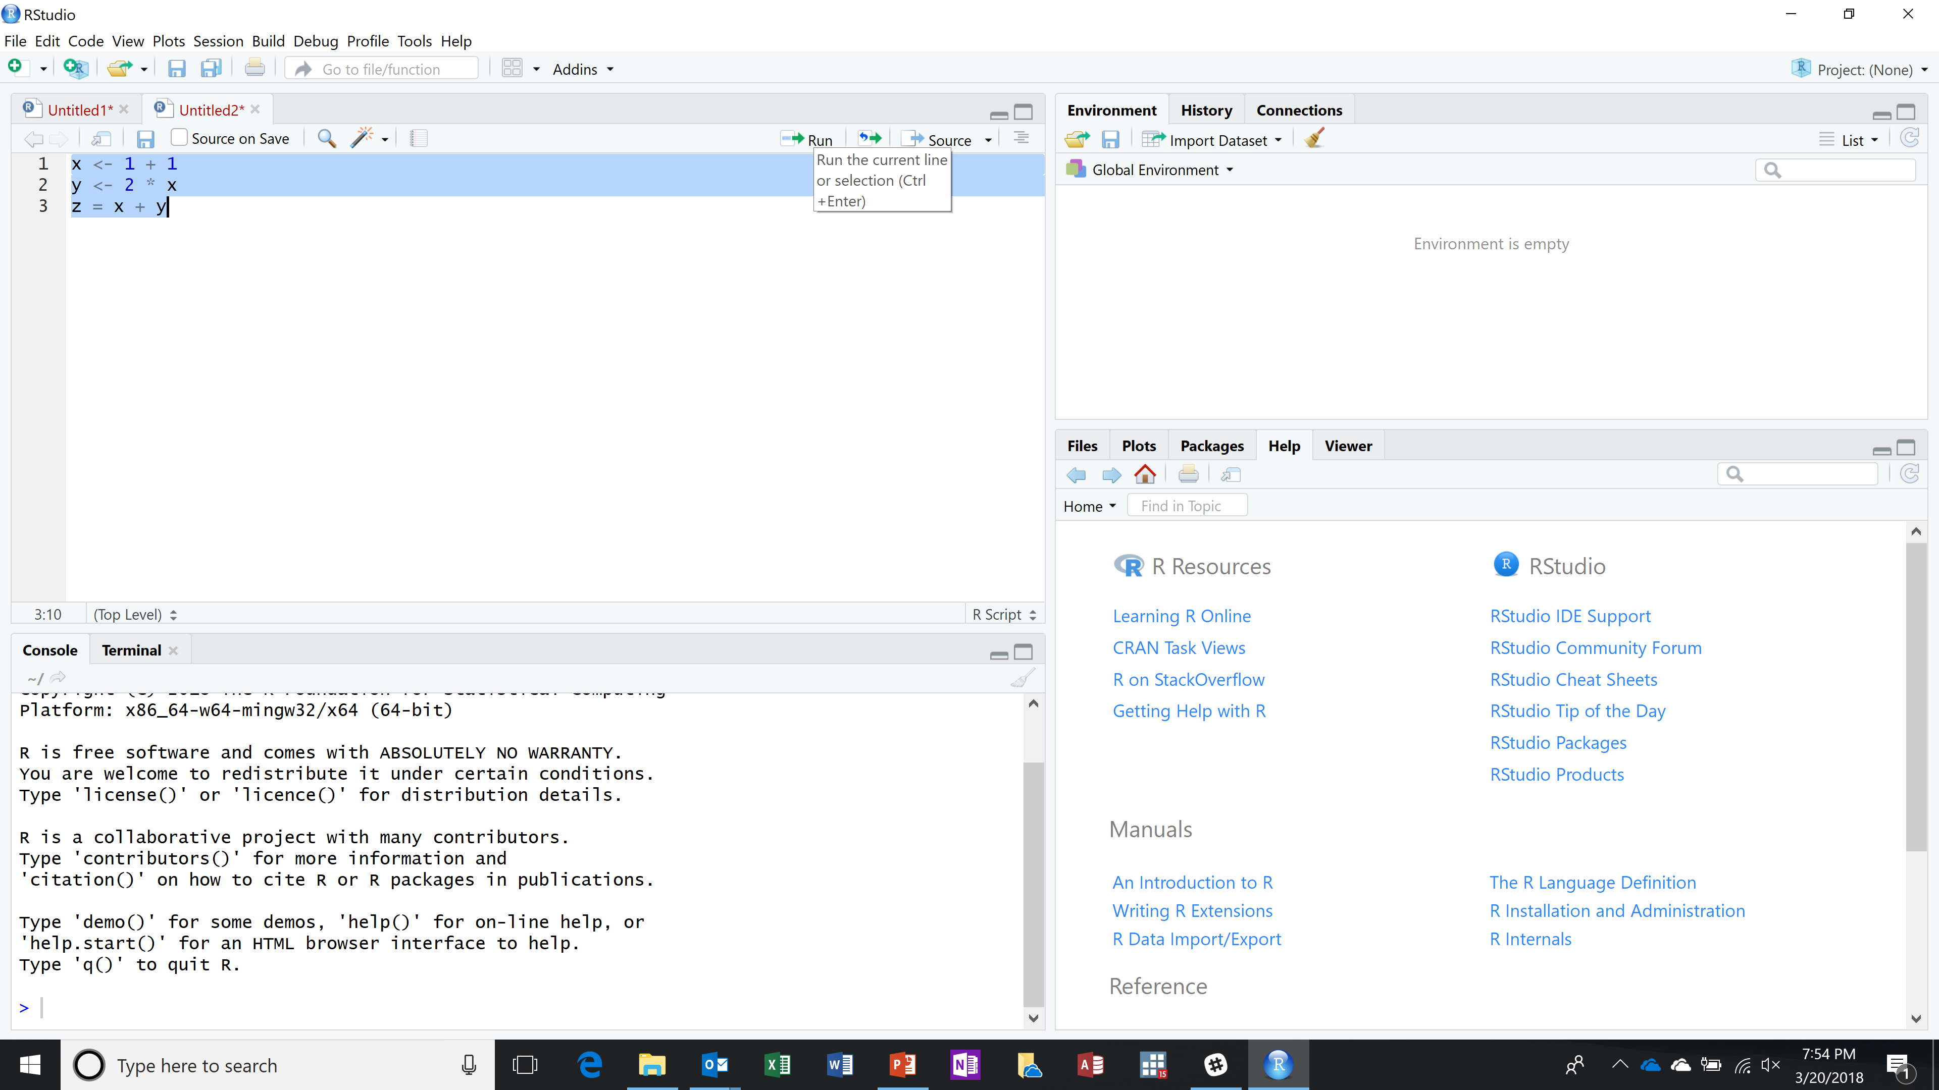
To run commands, I first highlight what I want to run, and then click the run button above
Notes:
Typing commands via the script window is not necessary,
we can always type directly into the console like we did before.
But I almost always type into a script and then execute or run the script.
Part of this is that scripts help reproducibility, the ability to rerun something and get the exact same answers again.
If you just type something directly into the console, you might not remember exactly what you did.
I don’t know how many times in my career when I was supposed to do something just once,
Only days/weeks/months/years later redo the same process again.
I don’t have that memory, and I gave up trying.
So I put everything in a script, and save the script unless I know for sure I won’t need it.
I’m not saving scripts today because I want everybody to experience typing and how RStudio gives you hints when you make mistakes.

Slide 28
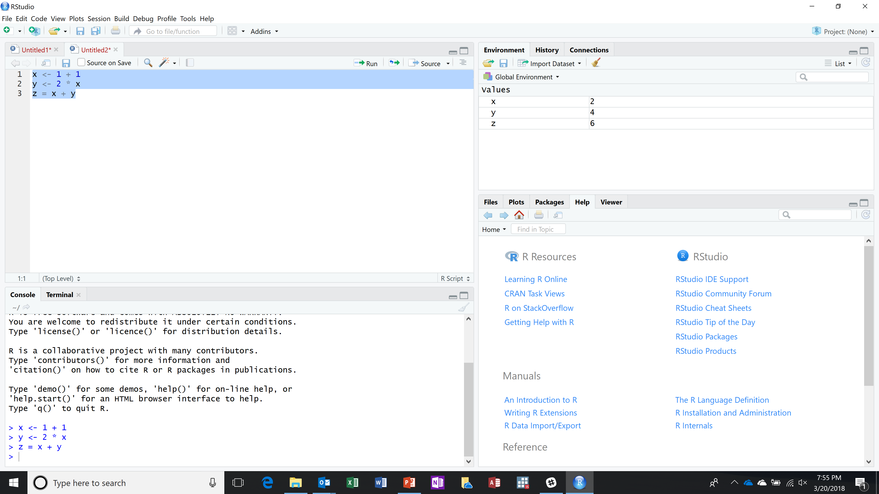
The console ran the commands, and I see the values in the environment window
Notes:
I have to admit that I like RStudio for just this one feature alone. It’s certainly worth the price (free) and more.
But I say this about a lot of RStudio’s functionality.

Slide 29
Introduction to Graphs and Plots
We need some data first. Later we will show you how to import some actual data into R, but for now I will fake it with random numbers.
One way to create random numbers from a standard normal distribution is to use a built-in function called “rnorm(n)” in which n is the number of values you would like to get
Notes:
I could have used a built-in data source, but I actually like random numbers.
And I might want to save the discussion of built-in data sources until after this section – literally “for another day.”
In finance we use random numbers a lot in Monte Carlo simulation.
Sources: See page 7 of Torfs & Brauer and page 17 of Dixon’s Introduction to RStudio

Slide 30
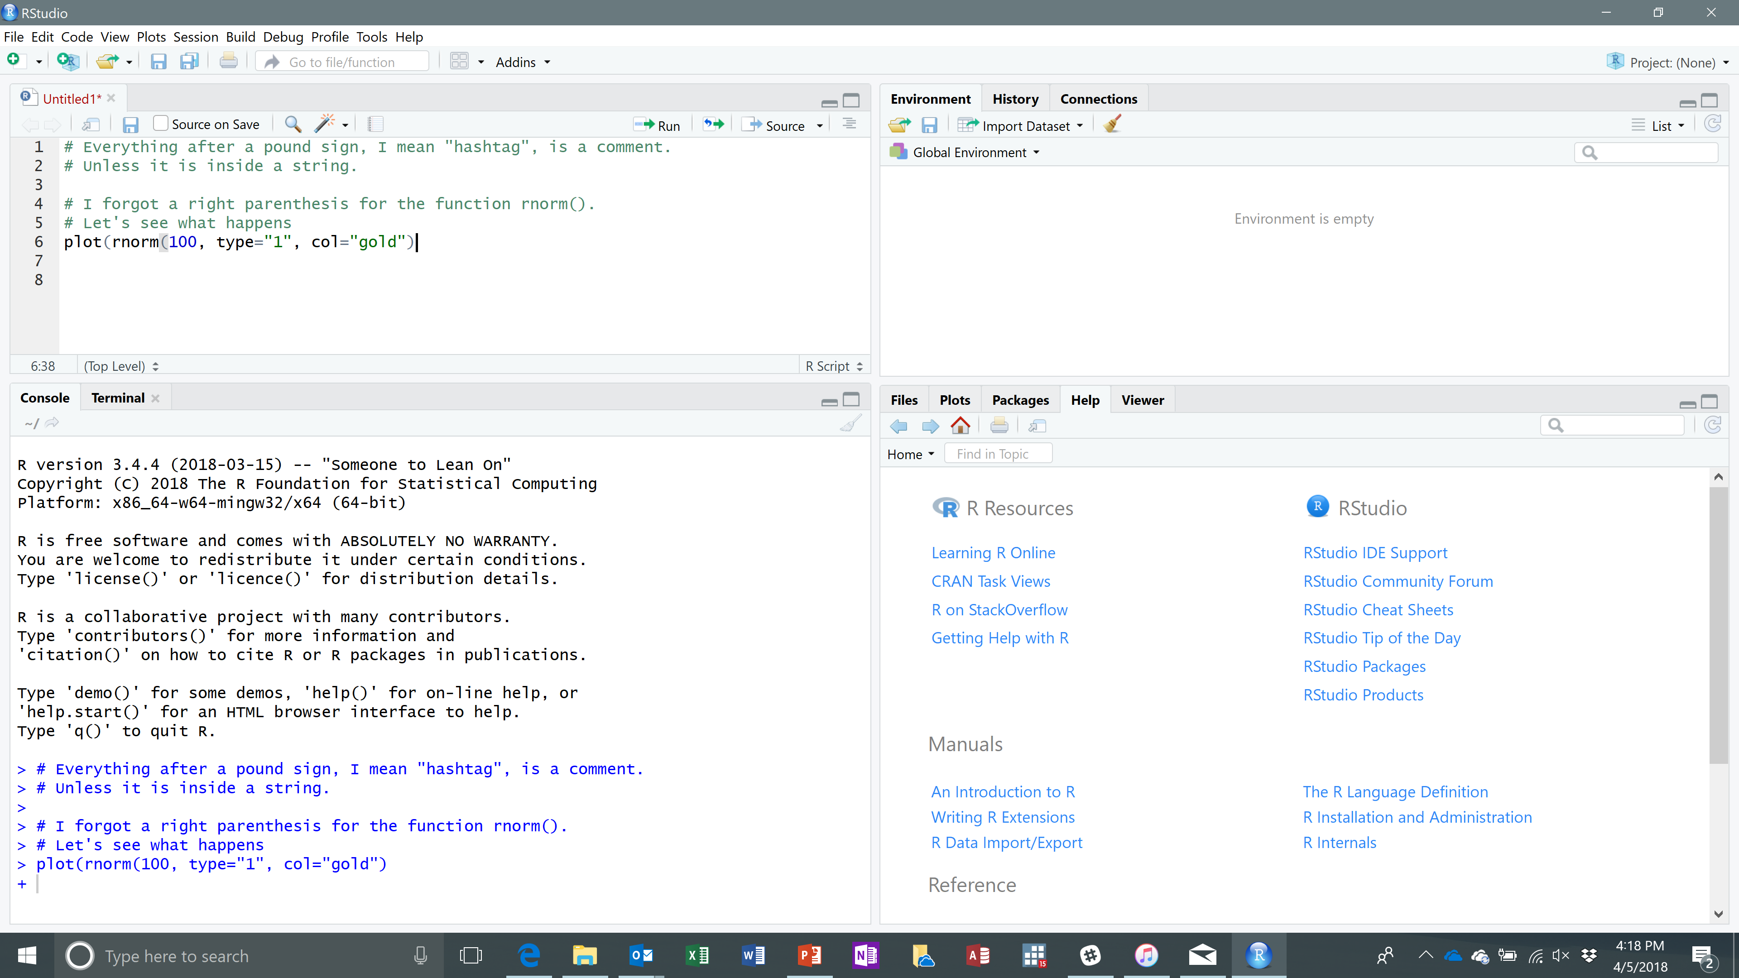
Side-Track: I Deliberately Make a Mistake
Notes:
If you notice, Rstudio is trying to tell me that I’m missing a right parenthesis. It says the last one I typed in matches the left parenthesis for the rnorm function call.
This is a real handy feature, but let’s pretend I did not notice that…just to see what happens.
I actually made two mistakes: in addition to forgetting the right parenthesis, I put in the number one rather than the letter ell.

Slide 31
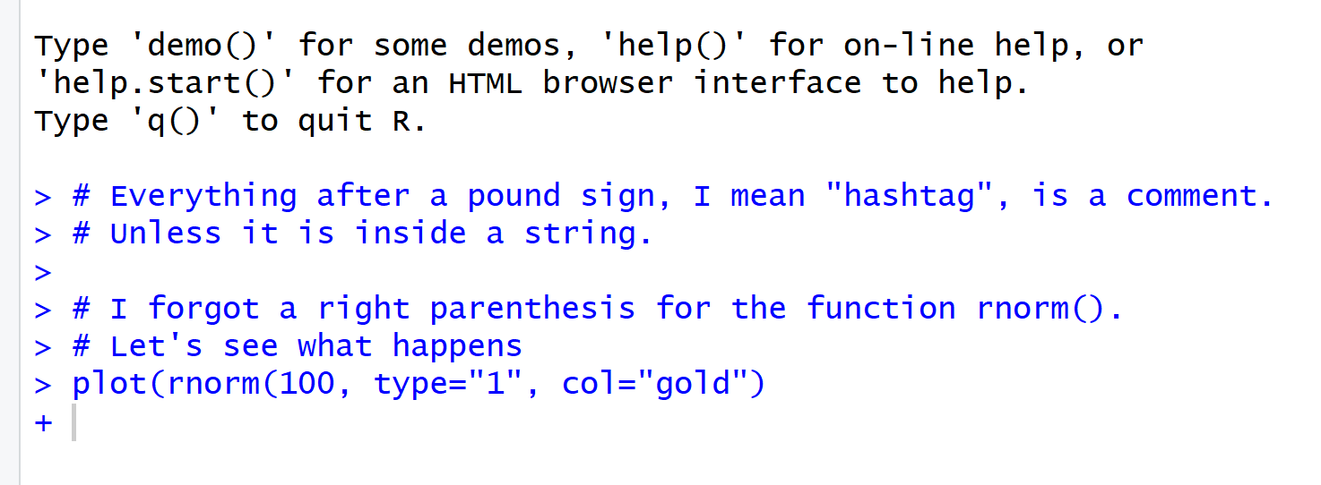
Select Everything and Run…
Notes:
…and the system is basically saying “Yes, go on. Finish what you’re saying. I’m waiting…”

Slide 32
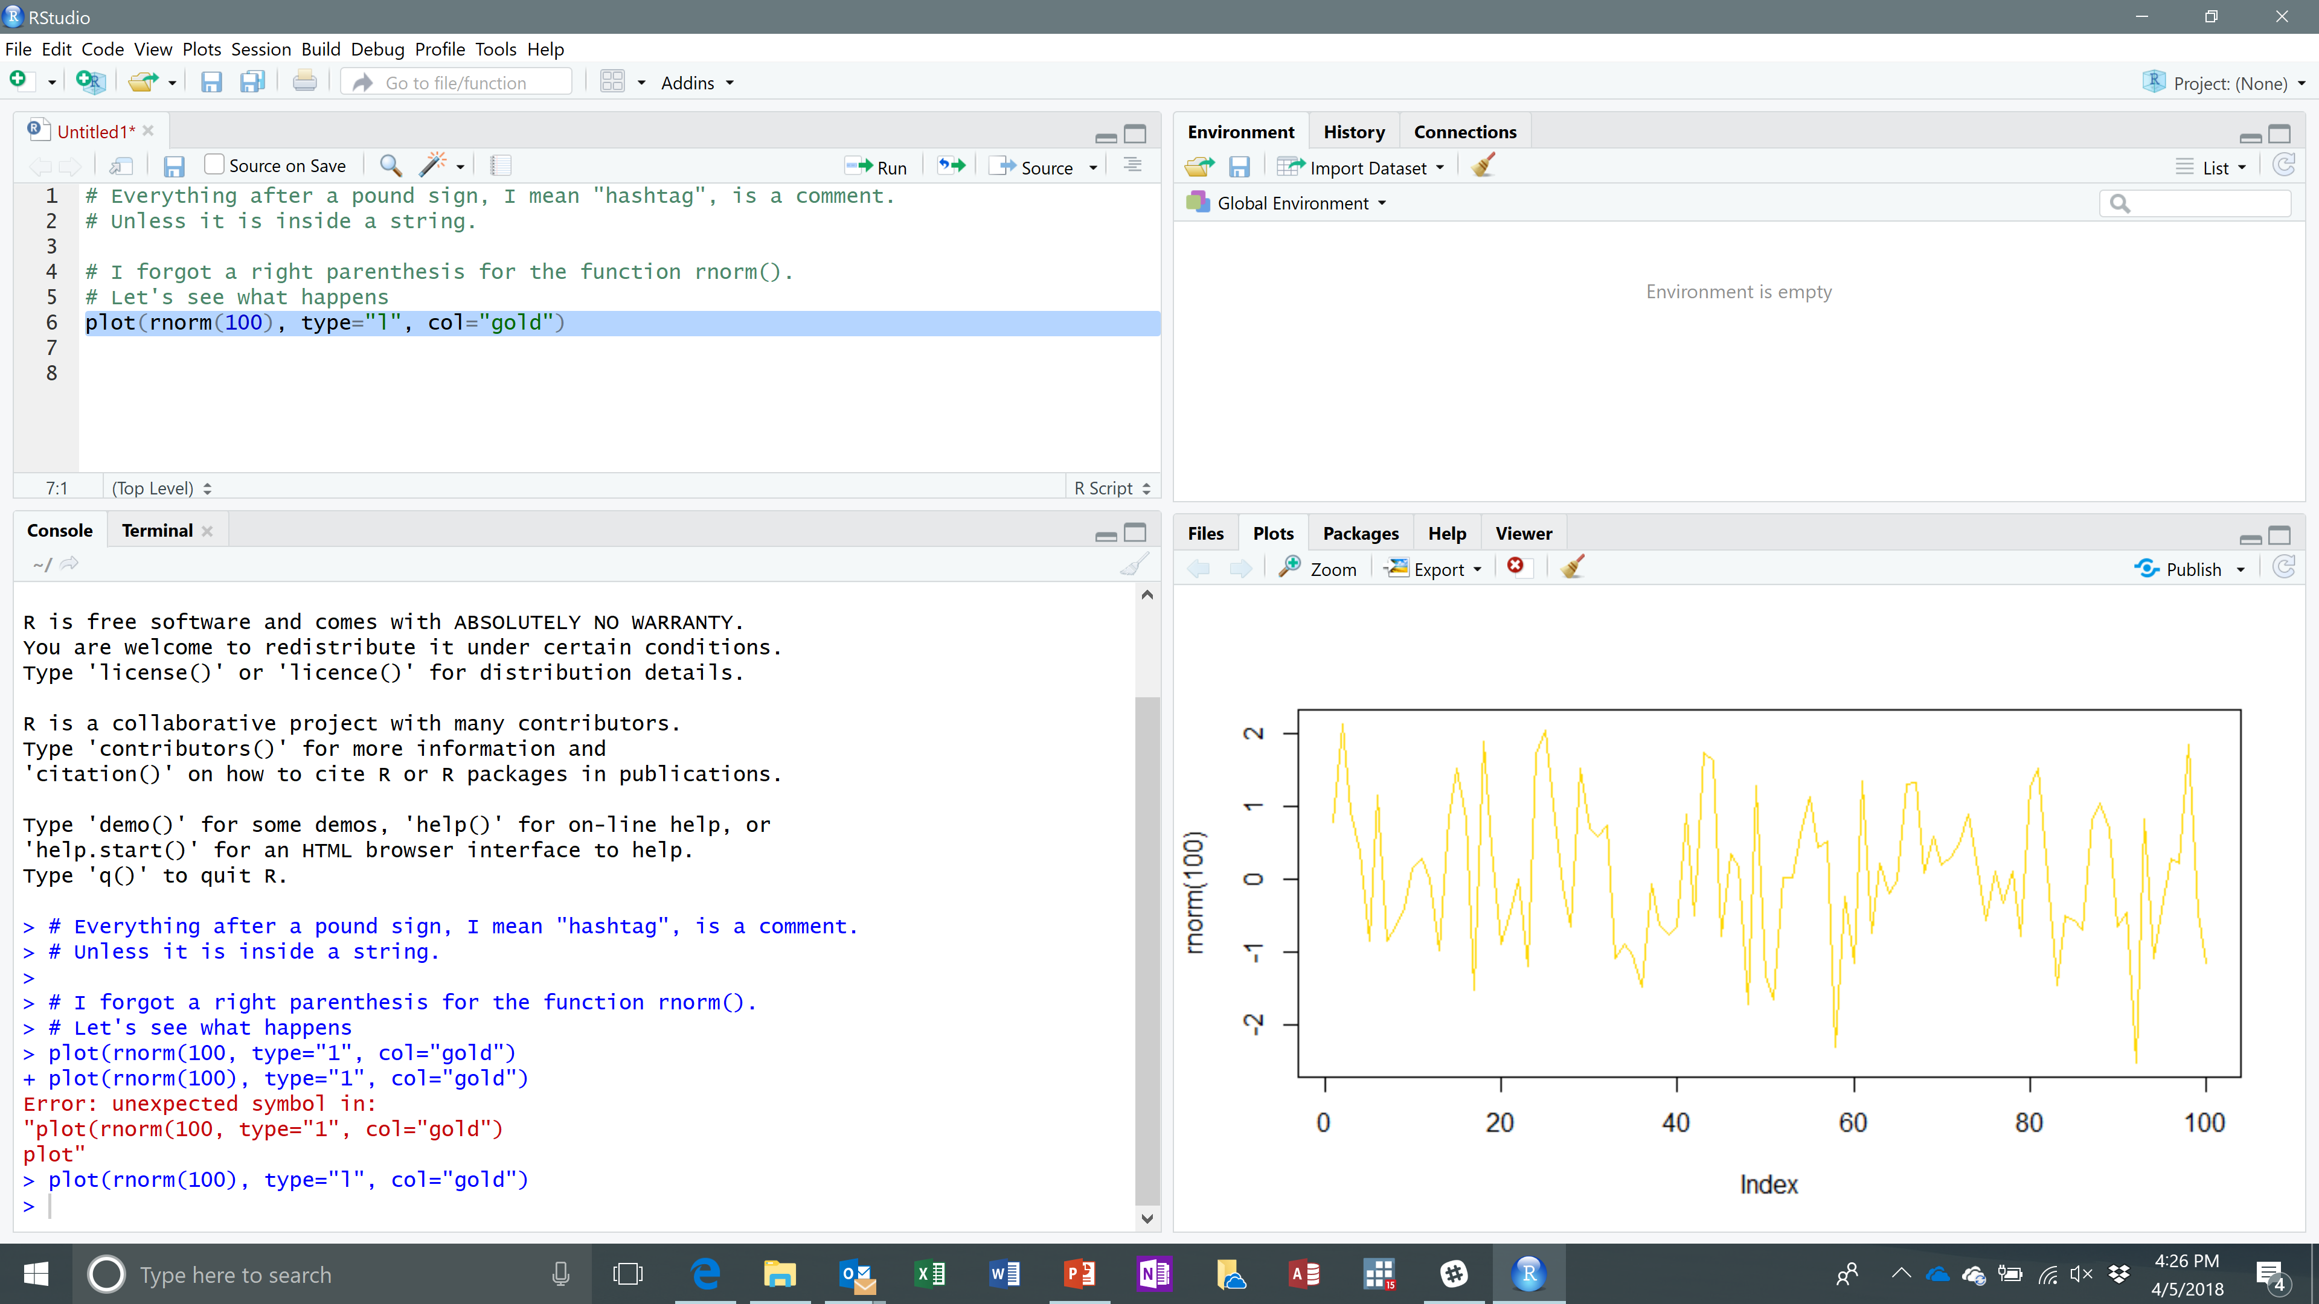
I Made Another Mistake
I intended the chart to be “ell” for line chart, but I accidently (sic) typed a “one” instead.
I’m sure you would have seen this except the screenshot is too small.
Once corrected, I have a line chart (which is what “ell” stands for) and the color of the line is gold.
Notes:
What other types of plots are there? Try “help(plot)”
"p" for points,
"l" for lines,
"b" for both,
"c" for the lines part alone of "b",
"o" for both ‘overplotted’,
"h" for ‘histogram’ like (or ‘high-density’) vertical lines,
"s" for stair steps,
"S" for other steps, see ‘Details’ below,
"n" for no plotting.

Slide 33
A Comment on Comments
Comments are good, but too much of a good thing is bad. Pointing out the obvious is condescending
It’s confusing and/or annoying if the comments do not match what the code actually does
A convention is to put a space after the pound sign (I mean hashtag)
Notes:
The computer doesn’t really care what, if anything comments say…so you do not need to make any comments for the code to work properly.
But people do care, and some comments are good.

Slide 34
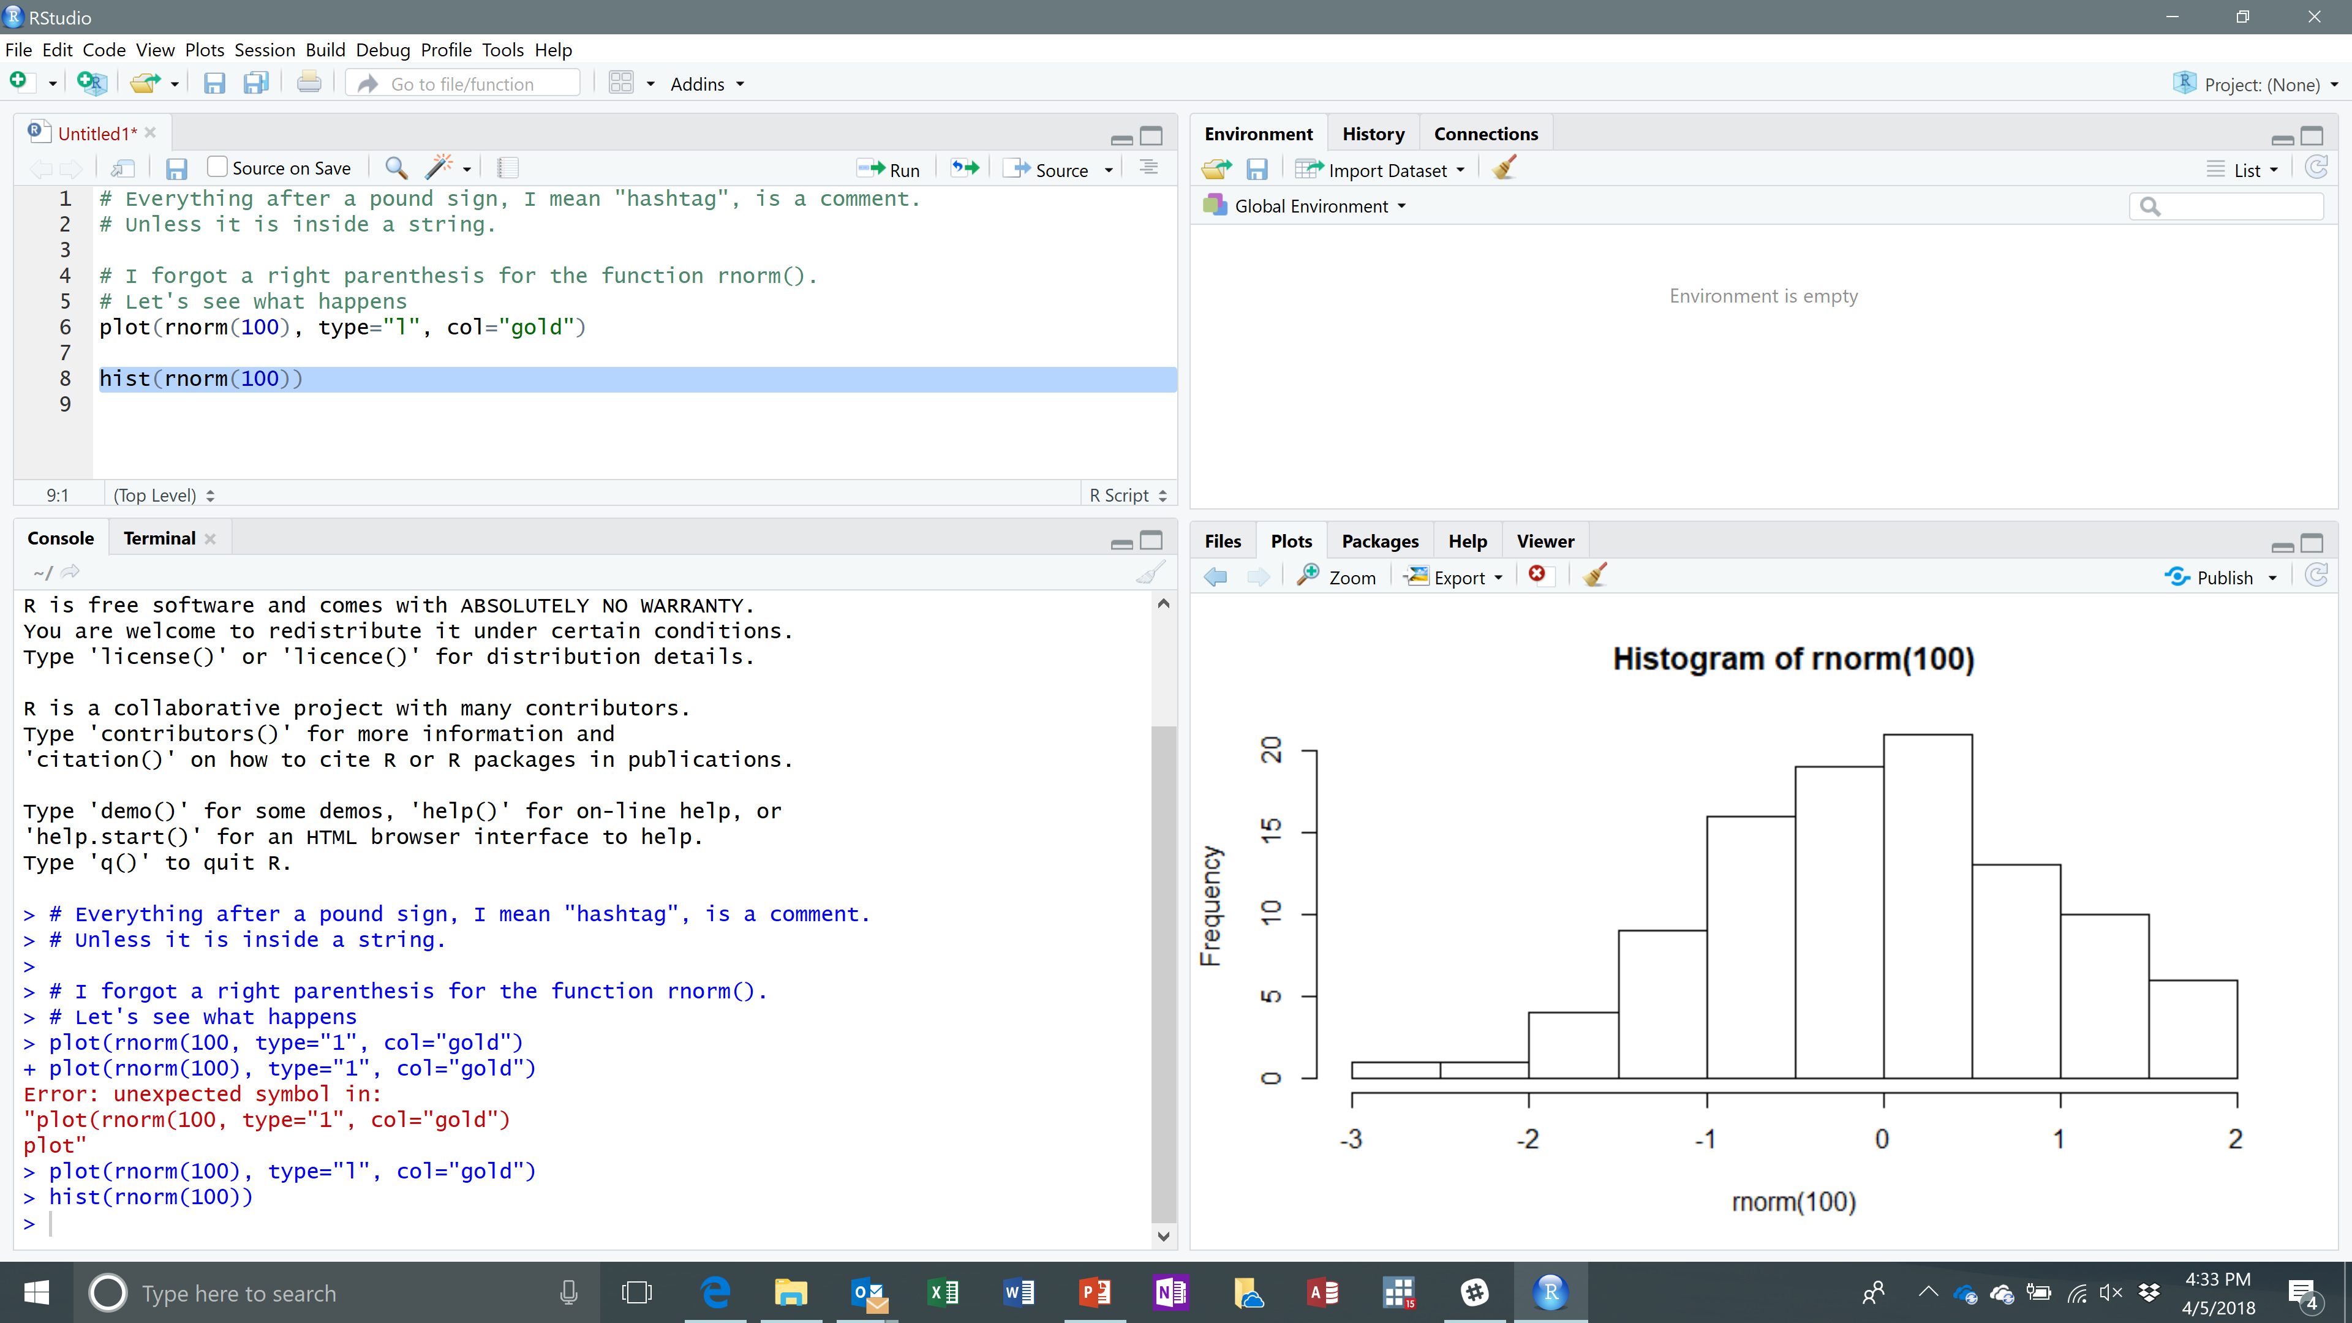
Let’s Try a Histogram
This histogram does not look perfectly normal because I’m using random numbers
Your histogram looks different than mine because you are using different random numbers
Notes:
This is supposed to look like a normal distribution, but something looks abnormal (pun intended).
The deal is that due to random “luck of the draw” I got some really low values without really high values.
Sources: See page 7 of Torfs & Brauer

Slide 35
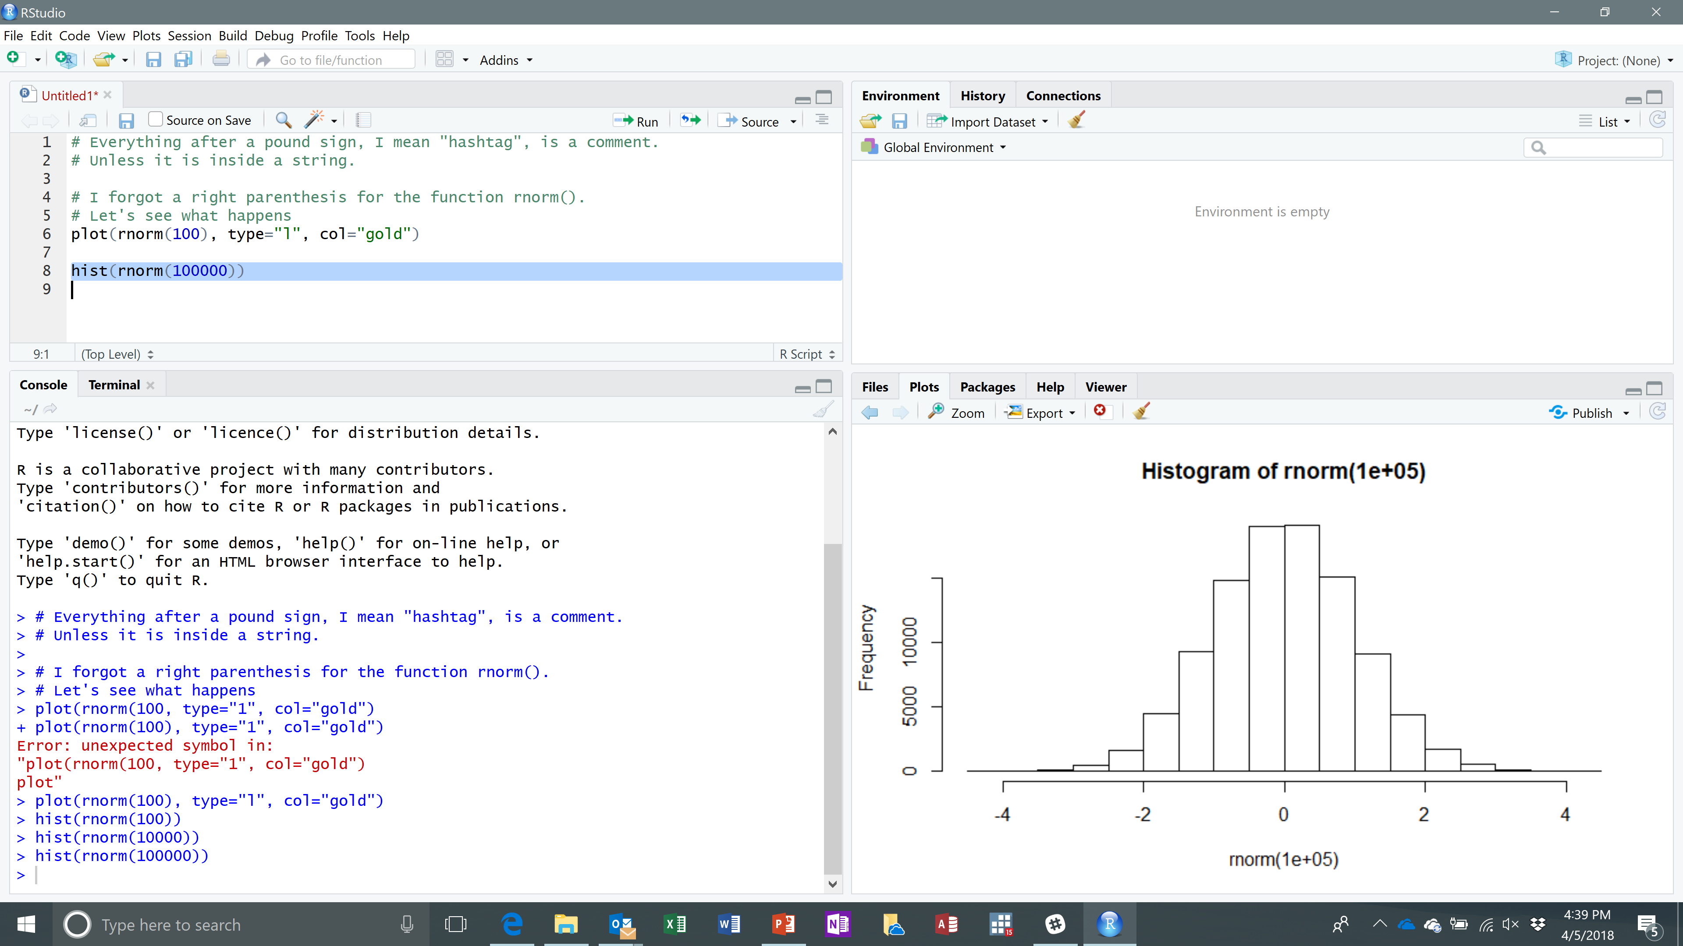
Try Again with Moar
Using many more random numbers “evens out” the randomness.
We get closer to the expected standard normal distribution
Notes:
If it wasn’t on a Saturday, I would use terms like the “Law of Large Numbers” and maybe talk about the “Central Limit Theorem”
but it’s the weekend and we’re not here for that.
If you notice, the chart is not very presentable because the chart title, and the ex-axis label isn’t great.
We can improve on that, and a whole lot more, but that’s the subject for another lesson.
For now, all I want to do is show how easy it is to make a somewhat OK looking chart.
This is fine if I’m the only person looking at the chart. Or I have members on my team who are understanding.
But this is not something I would want to show my boss. Or my bosses’ boss. Or my bosses’ bosses’ boss…

Slide 36
Back to Data Structures
R allows you to save multiple values in a single variable
Scalars – a single value We’ve seen these before
Vectors – a series of values We’ve seen these before
Matrices – a vector of vectors
Lists – not quite vectors because we can mix-n-match different things
Data Frames – nicely arranged data
Notes:
Sources: See page 6 of Torfs & Brauer

Slide 37
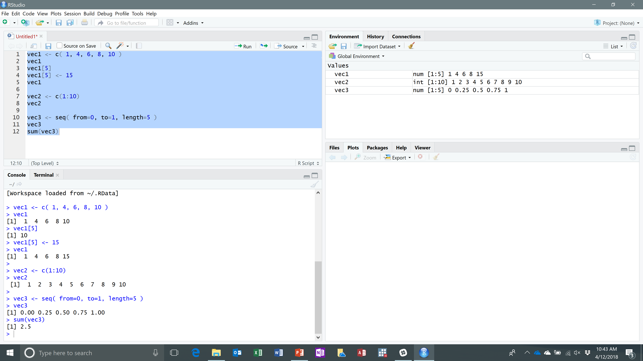
Data Structures: More about Vectors
We can access and change a single value inside a vector/list
We can create a whole bunch of elements at once using “:” and “seq()” function
Notes:
Sources: See page 7 of Torfs & Brauer

Slide 38
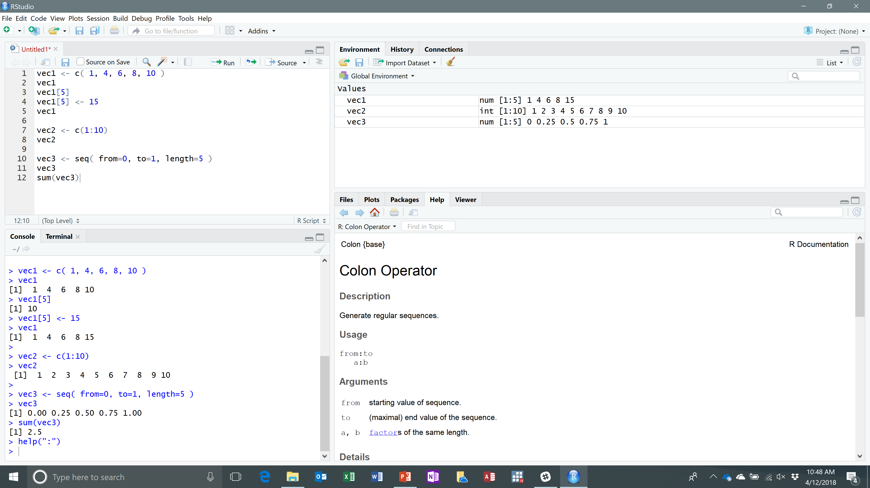
Type help(“:”)
The help window shows us the documentation for the help operator.
What happens if we try 10:1?
How do we get odd numbers from 1 to 99?
Notes:
For odds between 1 and 11; I would do this in two parts
t <- c( 0:49)
odds <- t*2 + 1
rm(t) # I like to remove variables as soon as I no longer need them
Perhaps we can put this together in a single statement
anotherWay <- c(0:49)*2 + 1
What about that sequence function from the previous slide?
thirdWay <- seq(from = 0, to = 99, by=2)

Slide 39
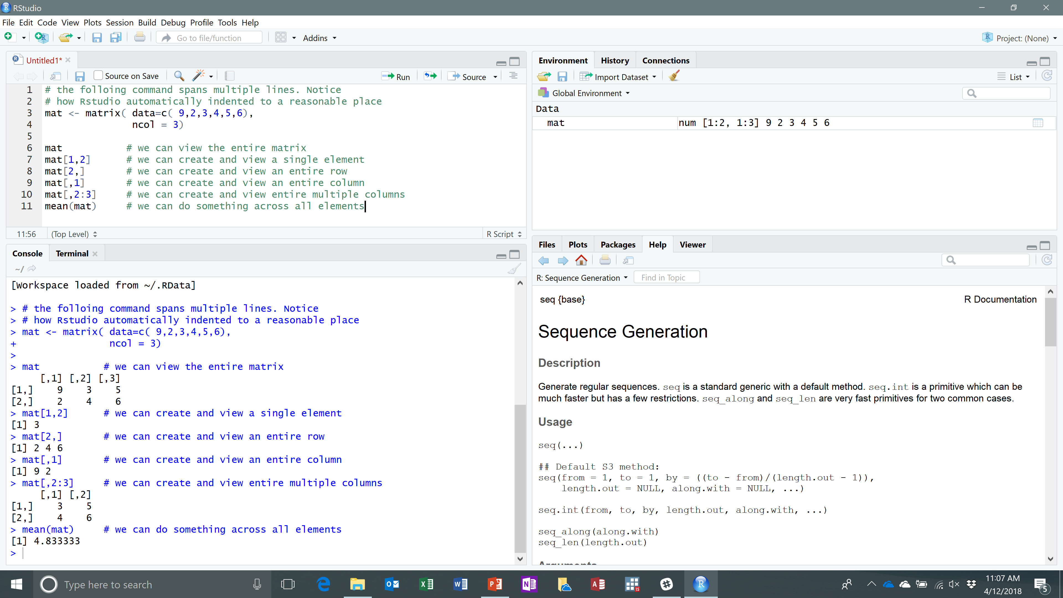
Matrices
Notice how the comments can be condescending for people who are familiar with R.
Notes:
In addition to using a range “2:3” I could create a list and use that: for example “c(1,3)” to see the first and third elements.
Sources: page 6 of Torfs & Brauer

Slide 40
Data Structures: Data Frames
A data frame is like a matrix except the columns have names
Or data frame is like a table in a relational database
Or a data frame is like data in a well-designed spreadsheet
Or a data frame is like a (insert analogy here)
Or a data frame is how most people use data in R
Notes:
Sources: See page 6 of Torfs & Brauer

Slide 41
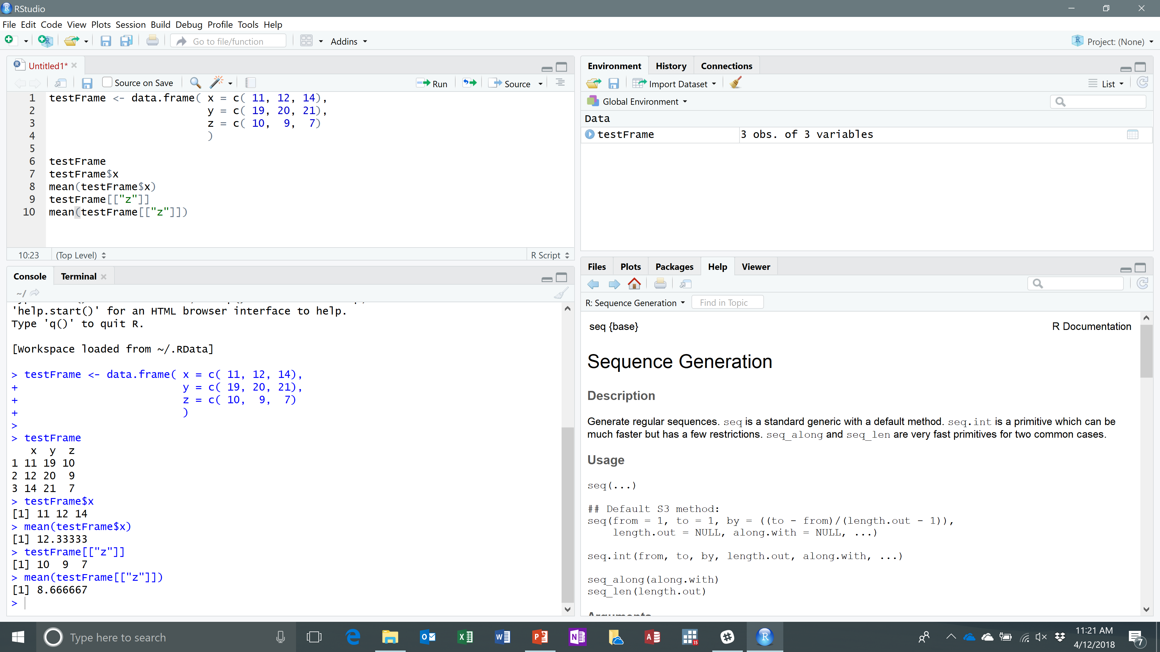
Data.Frame
Notice the function “data.frame” is a single name using the dot to separate the words
I can refer to individual columns of the data.frame
Notes:
I suppose I should have chosen more descriptive variables names than “x, y and z.”

Slide 42
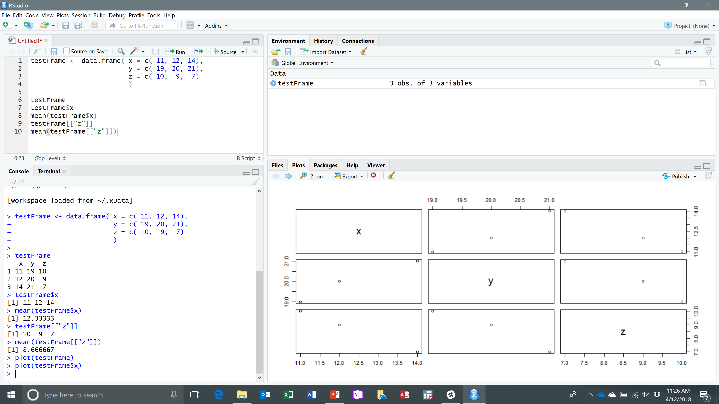
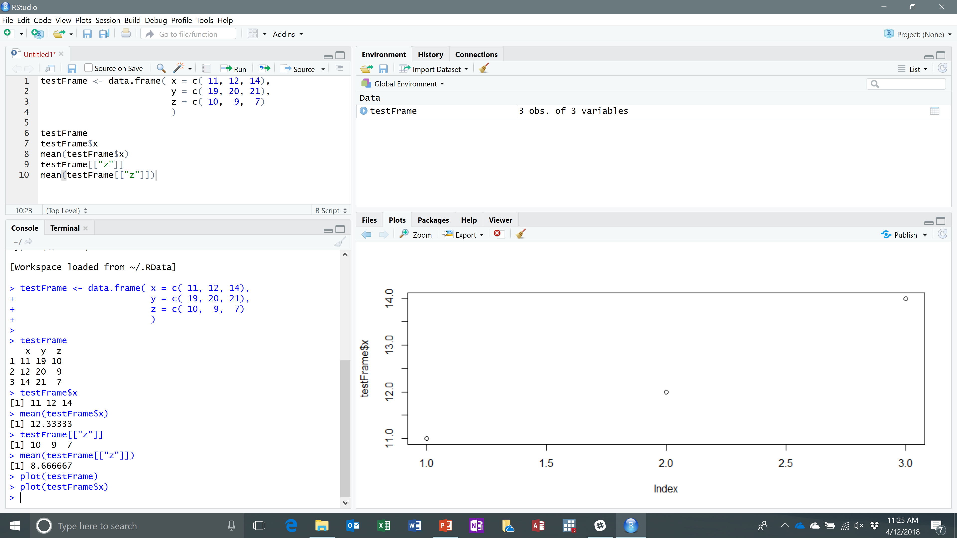
Graphics: Switching
Plot(testFrame$x) Plot(testFrame)
Notes:
Sources: See page 7 of Torfs & Brauer

Slide 43
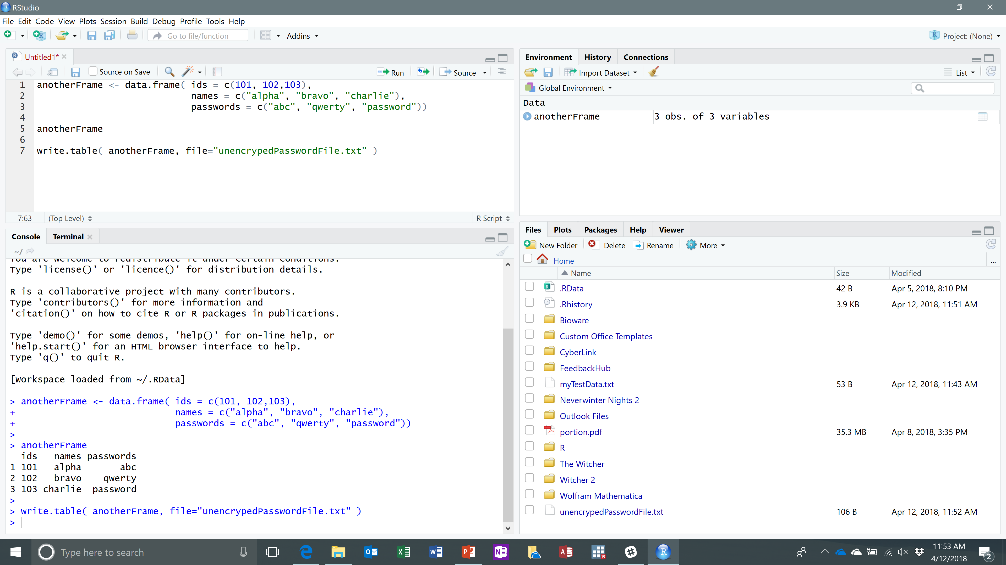
Reading and Writing Data Files
Notes:
Sources: See page 8 of Torfs & Brauer

Slide 44
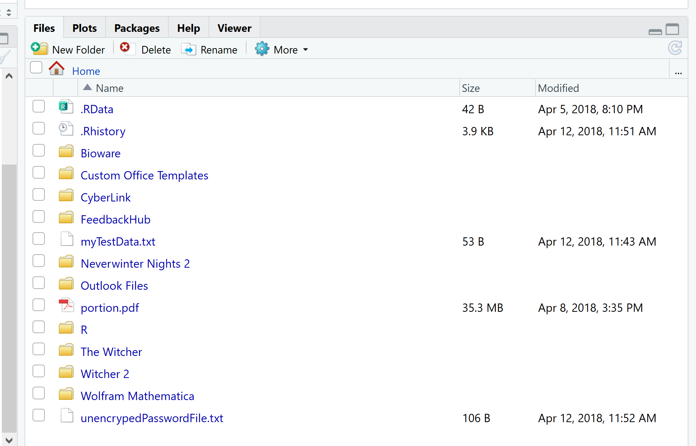
Files Section
There is a default working directory called “home”
It created the file
I can double-click it to see in the editor window…
Notes:
Where is this directory? For me it happens to be “one-drive\personal\documents”
And yes, I have some old-school RPGs installed on this machine. I don’t have time to play them any more, which is why I don’t have any new games.
The R command Sys.getenv(“R_HOME”) and yes with these capital letters, will tell you where this is.
The r command Sys.getenv() will show you a number of environment variables that you can use and change, I guess.
The next slide shows where this home default working directory is.
Or we could type in the R command getwd()
Or we can select File > Change dir... and spot it from there

Slide 45
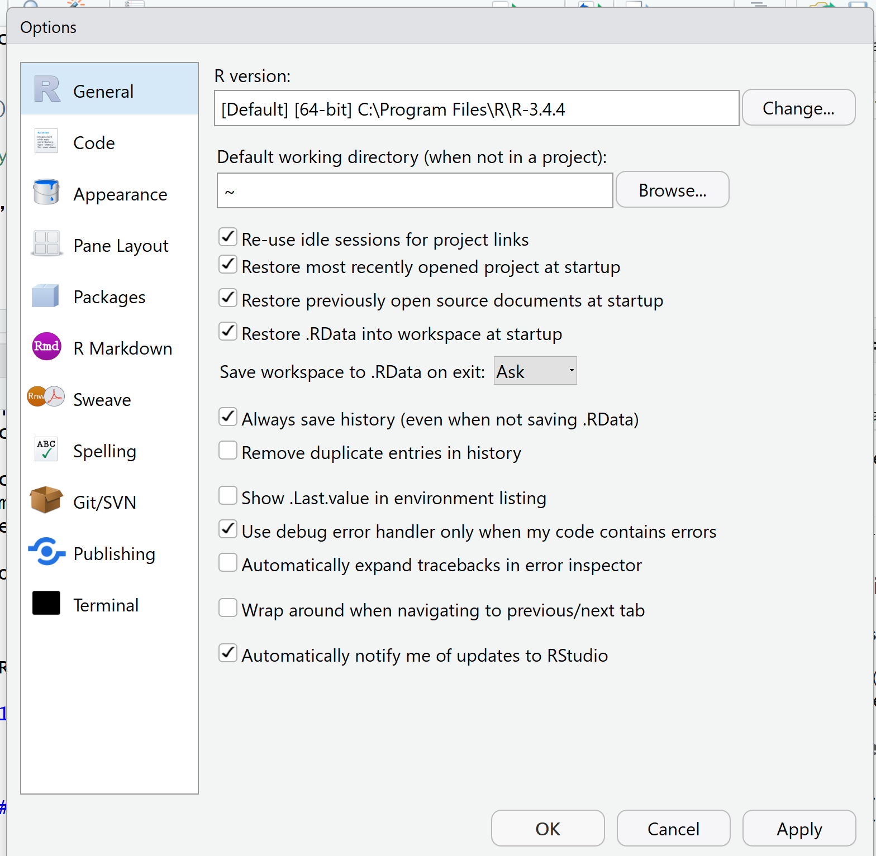
Where is this Working Directory?
In Rstudio, I clicked menu command Tools > Global Options…to get this dialog box.
The “~” or “tilde” character means this is the user’s default home directory
Click the “Browse…” button to find exactly where this is
Changing this sets the default location where everything else is saved.
Notes:
The contents in the “R version” is R_HOME
We can change the working directory either here, or with the R command: setwd(“directory”)
Or we can select File > Change dir... and change it from this dialog box

Slide 46
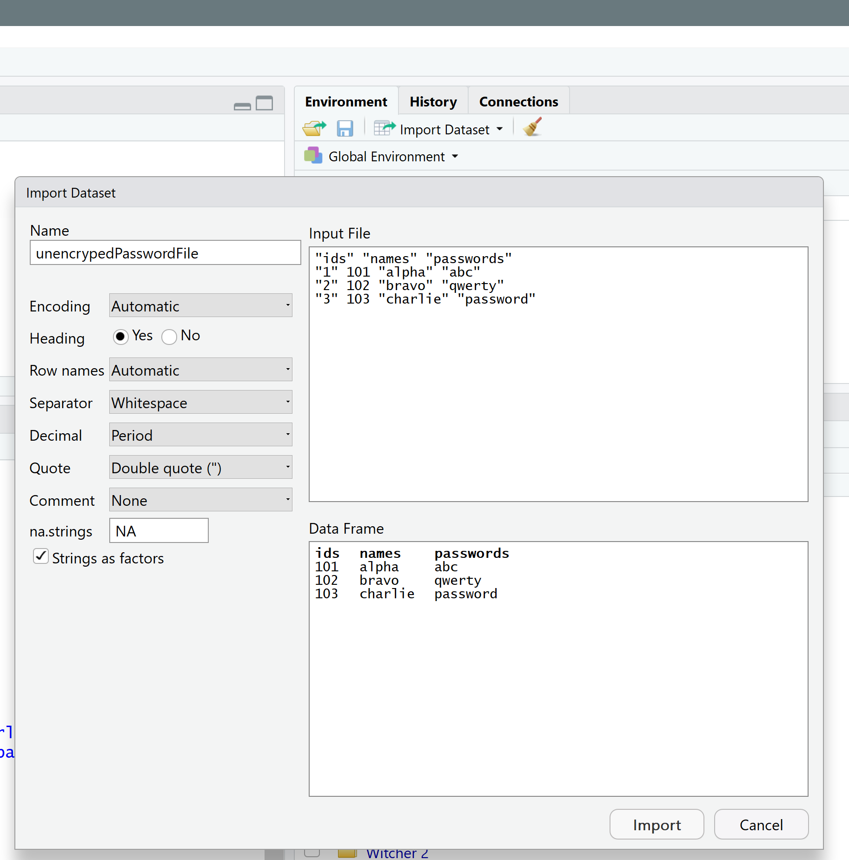
Reading Data
The function “read.data()” would work…but I want to show off the “Import Dataset” button
Impressive dialog box with options and preview

Slide 47
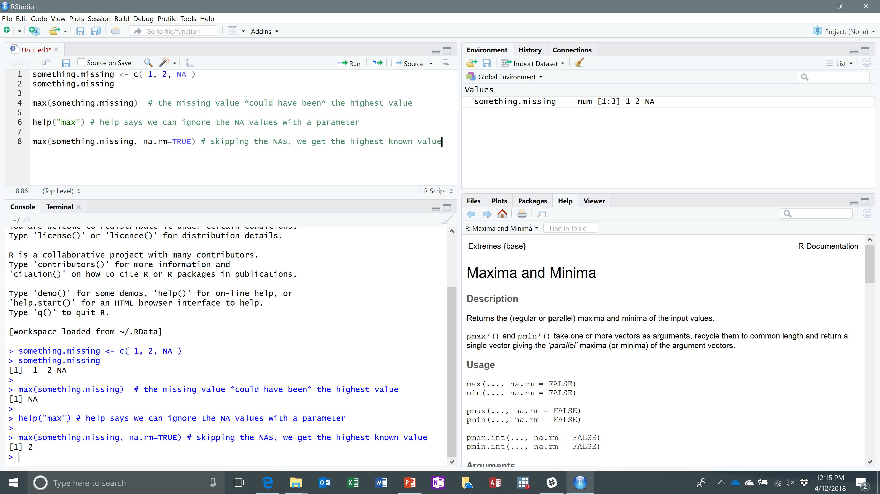
Not Available Data
Sometimes some data is missing and/or unknown
We can work around that
Notes:
Sources: See page 8 of Torfs & Brauer

Slide 48
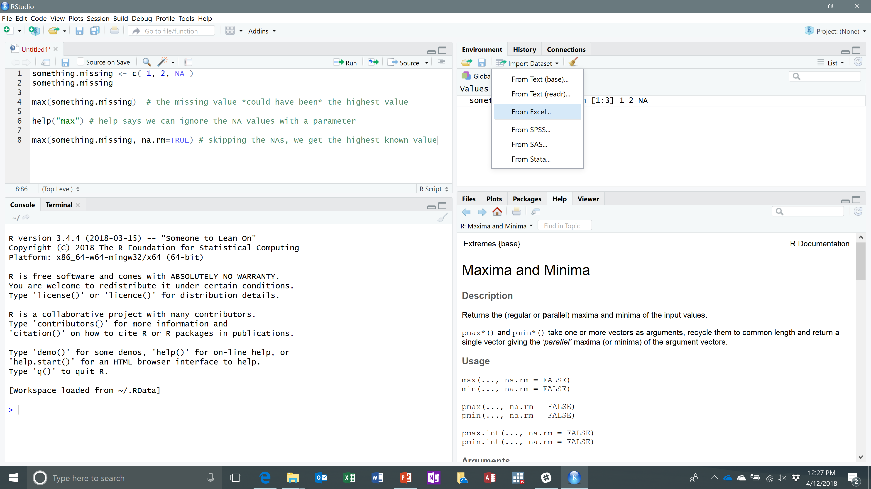
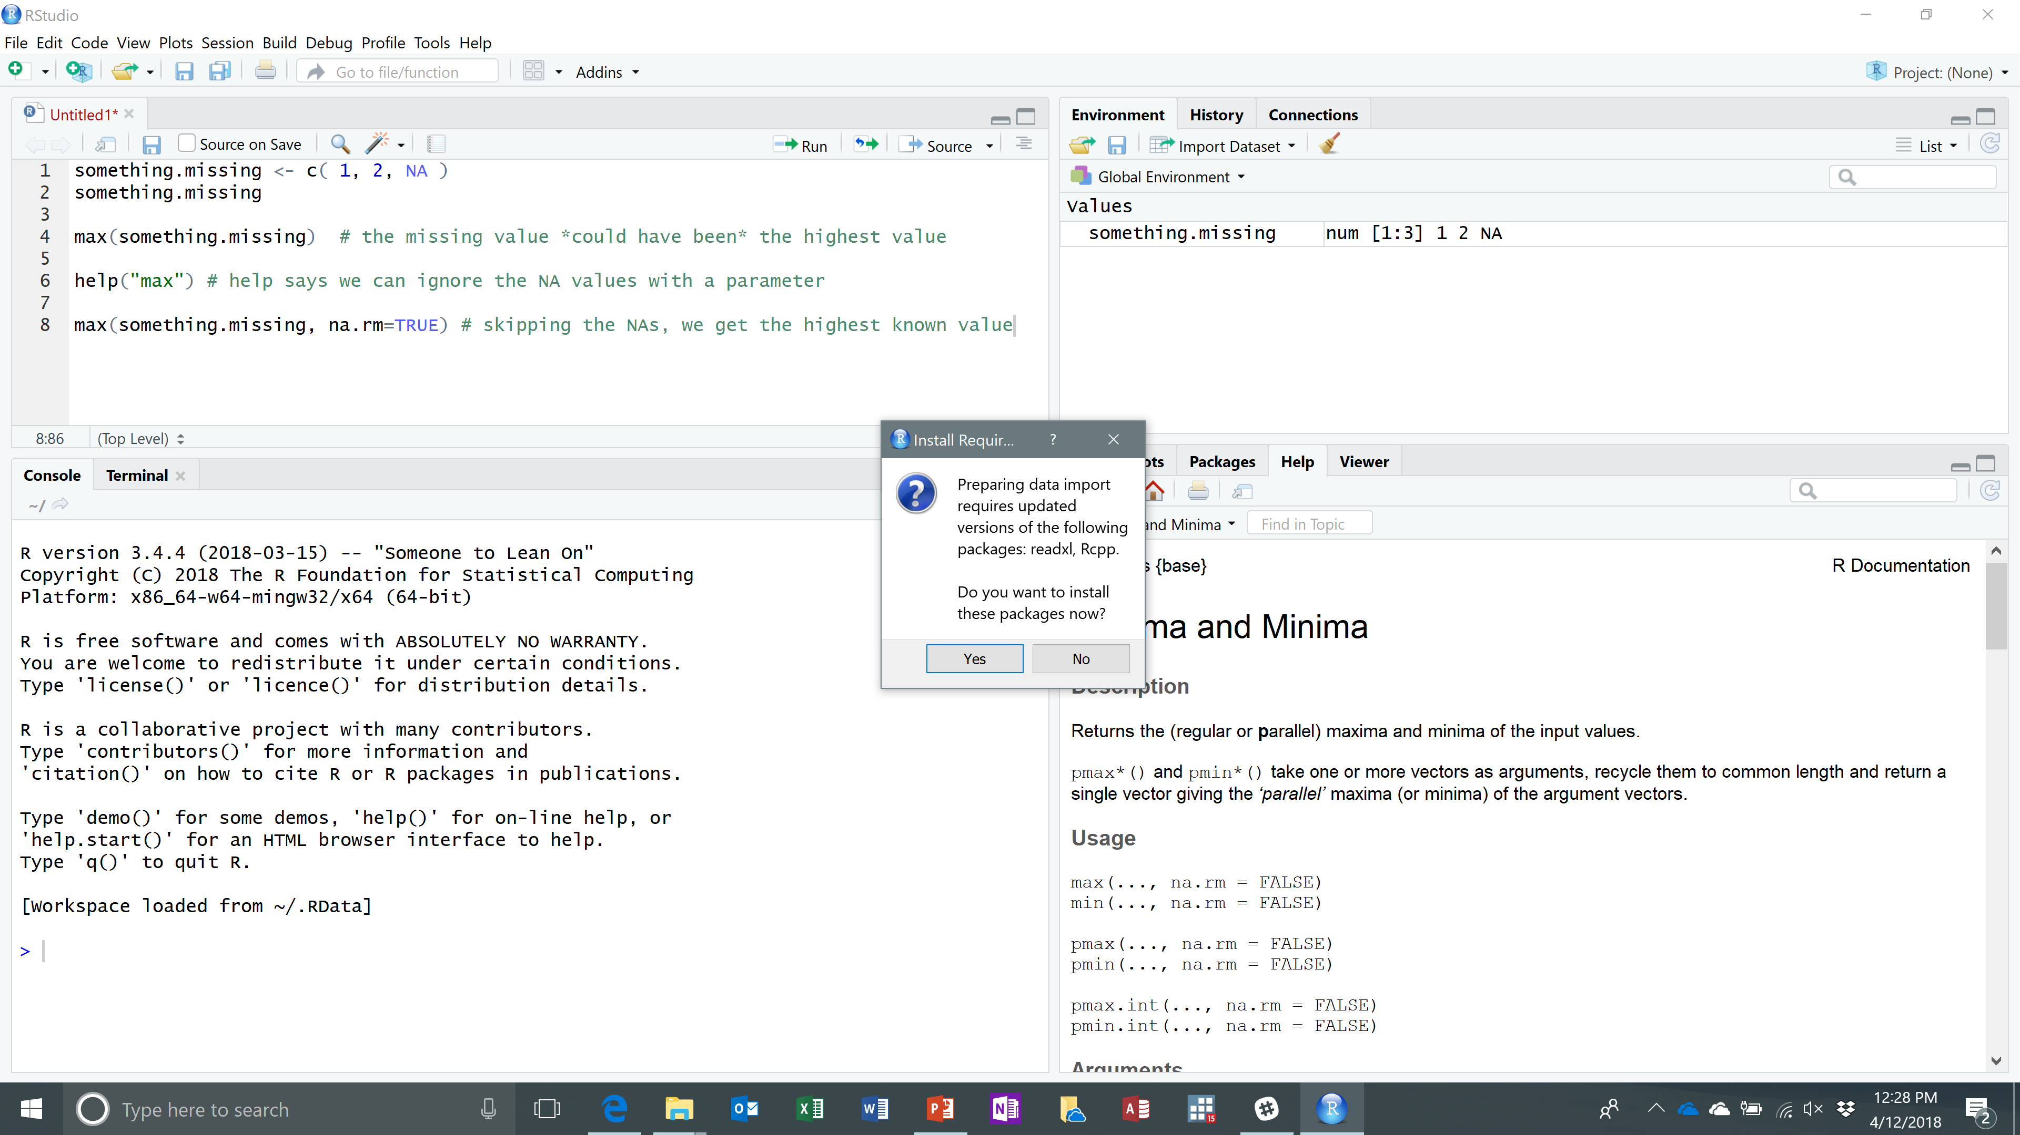
Importing Data: Different Formats
R cannot read other types of data files without some additional functionality. The way to add is via packages.
Rstudio recognizes you need additional help.
Notes:
Sources: See page 11 of Dixon’s Introduction to RStudio

Slide 49
Installing Necessary Packages
Adding functionality comes in two portions
Download stuff to your computer
Install stuff so that R can use it.
RStudio knows what to do to import Excel files
I use a stats package for Stata, so installed this package as well
Notes:
There are two ways to see what packages are installed:
Type in library() as an R command
Look at the Packages tab in RStudio
Sources: See page 5 of Dixon’s Introduction to RStudio

Slide 50
Installing Other Packages
Via Rstudio: Tools > Install Packages… dialog box
Directly in r: command is install.packages(<package.name>)

Slide 51
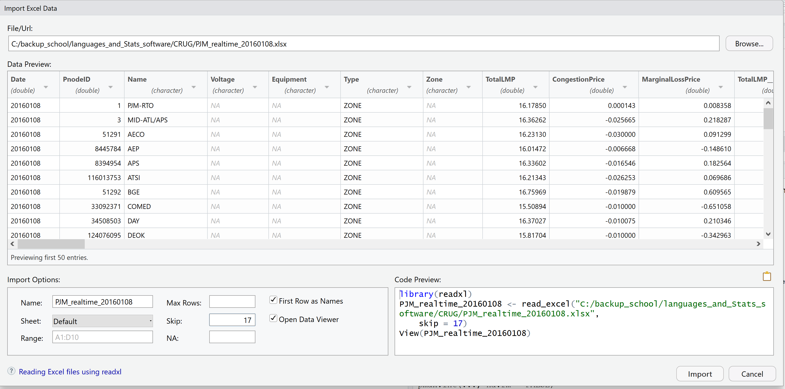
Importing Excel is Nice
Notes:
This data file I imported is from the JPM real-time (meaning hourly) energy prices from some day I picked out of the blue.
This particular data file has header information at the top, so I skipped the first 17 rows. The next row has the variable names,
And the rest of the rows have the data. Notice how R’s readxl package can tell which columns are numbers and which are characters.
Notice how Rstudio shows you how things look without having to understand all the code.

Slide 52
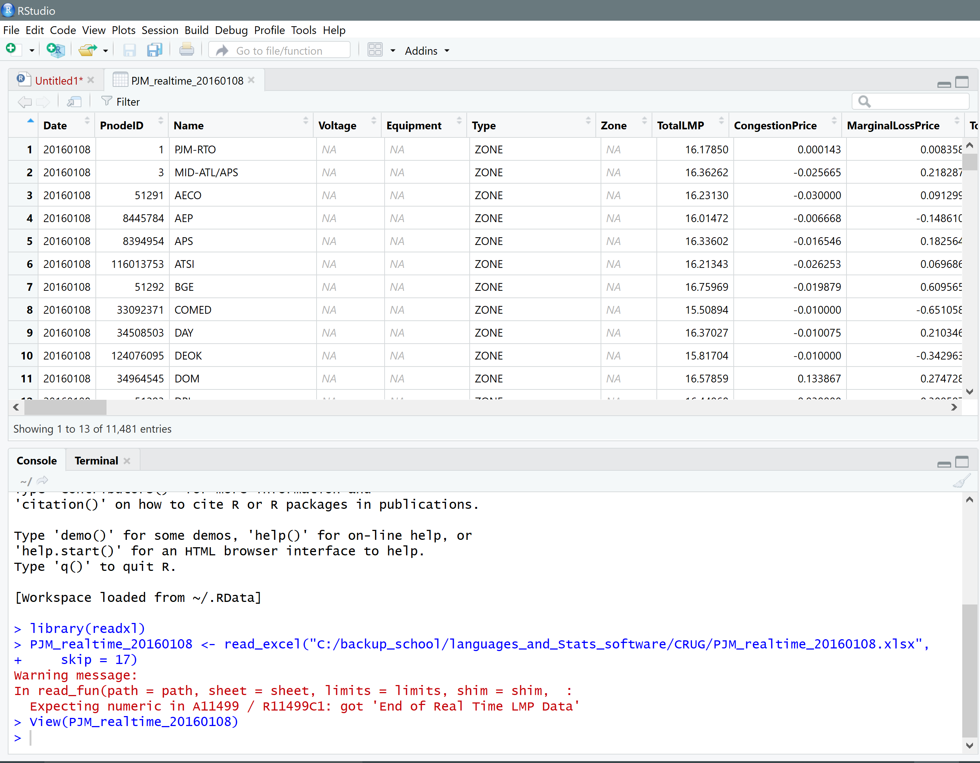
Importing
RStudio shows me the contents of the file
Rstudio shows me the command to run in R.
PS: the last line is not really data – R at knows something looks funny about it.

Slide 53
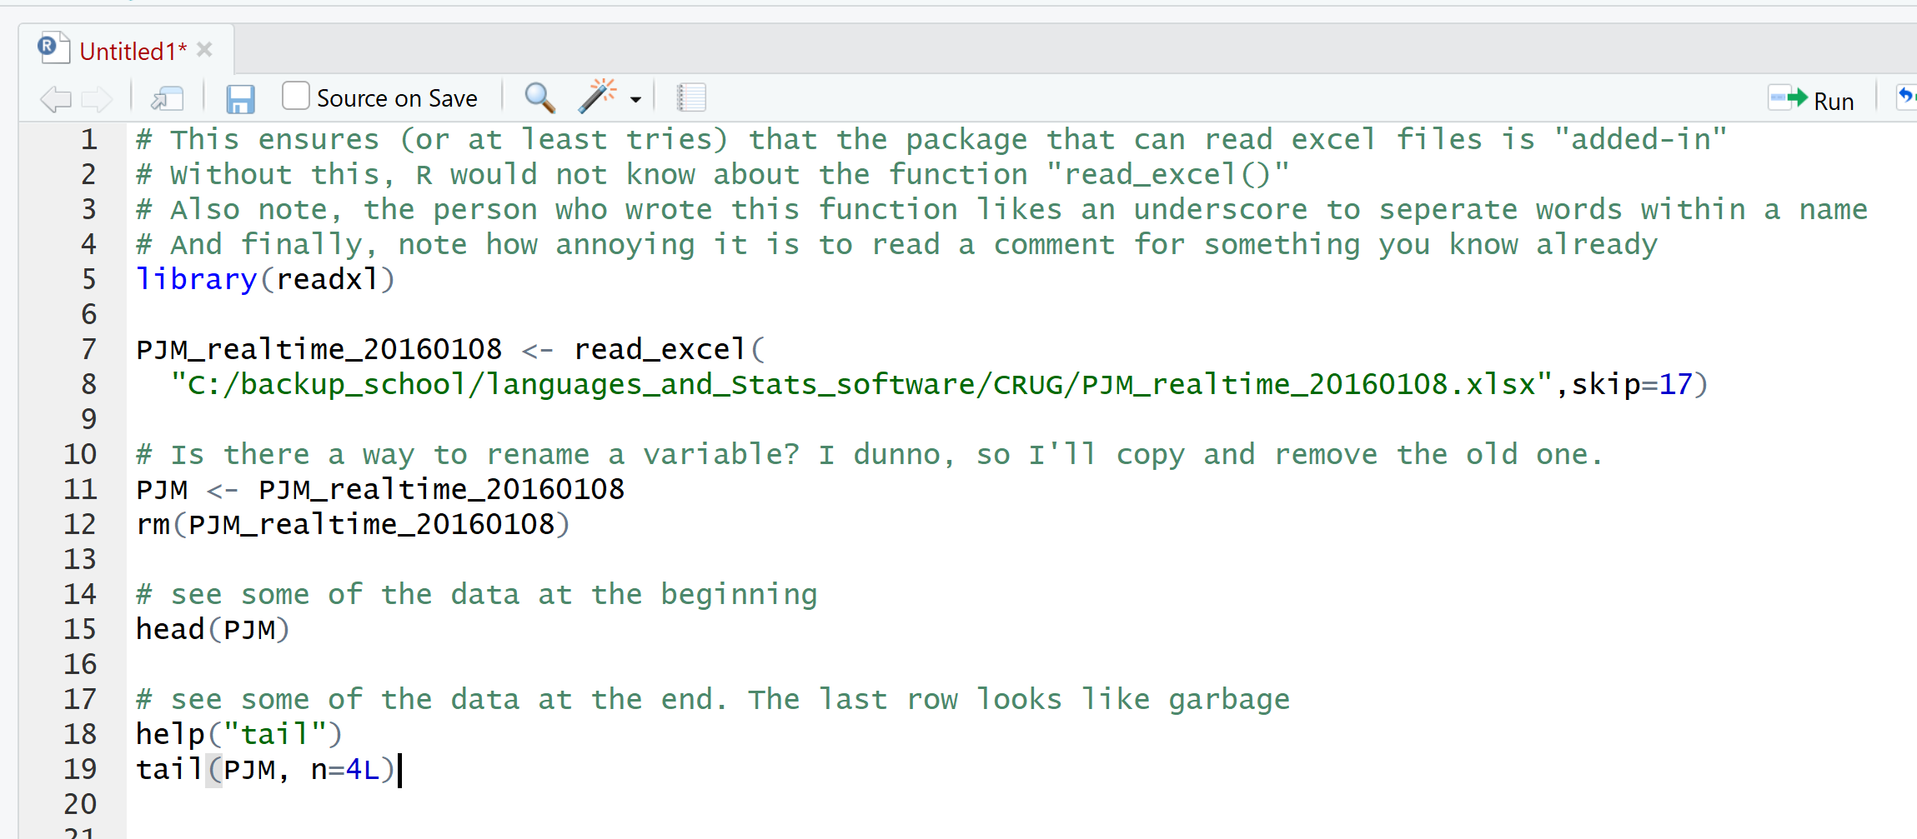
Viewing Data
Print()
Head()
Str()
Names()
ls()
Notes:
Sources: See page 16 of Dixon’s Introduction to RStudio

Slide 54
Classes (or Types of Variables)
Numbers: R (and other computer programming languages) have different types
Integers, reasonable precision reals, extra precisions reals, imaginary
Strings of Characters (usually called just strings)
Dates
Boolean/logical
And more
Notes:
Sources: See page 9 of Torfs & Brauer

Slide 55
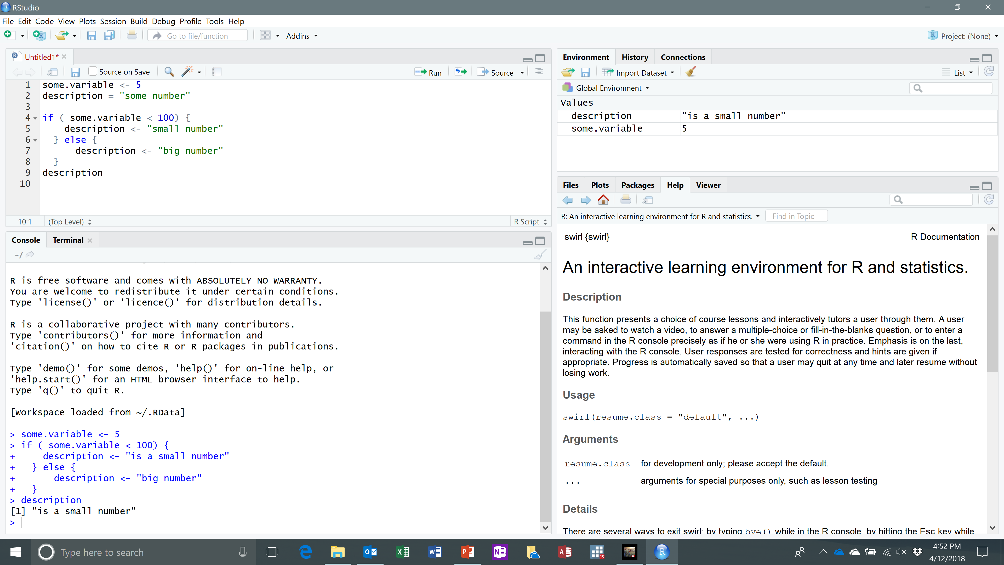
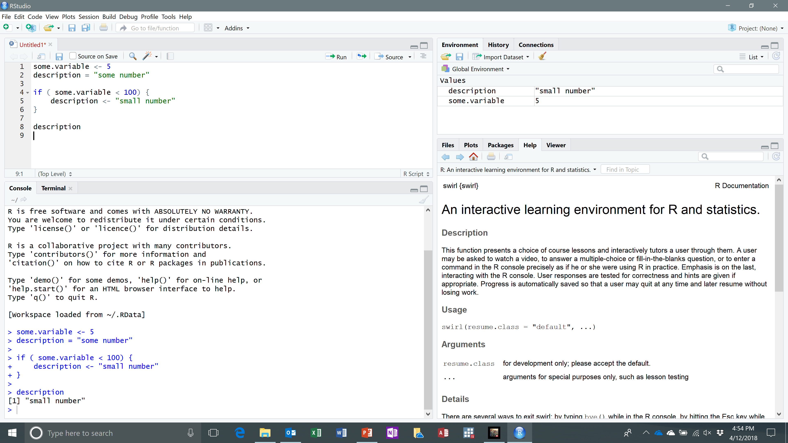
Programming Tools: IF
An IF statement is for when you want something done in some situations but not others.
Symbols: <, >, <=, >=, != (for not equal), & (for and), | (for or)
Notes:
Sources: See page 9 of Torfs & Brauer

Slide 56
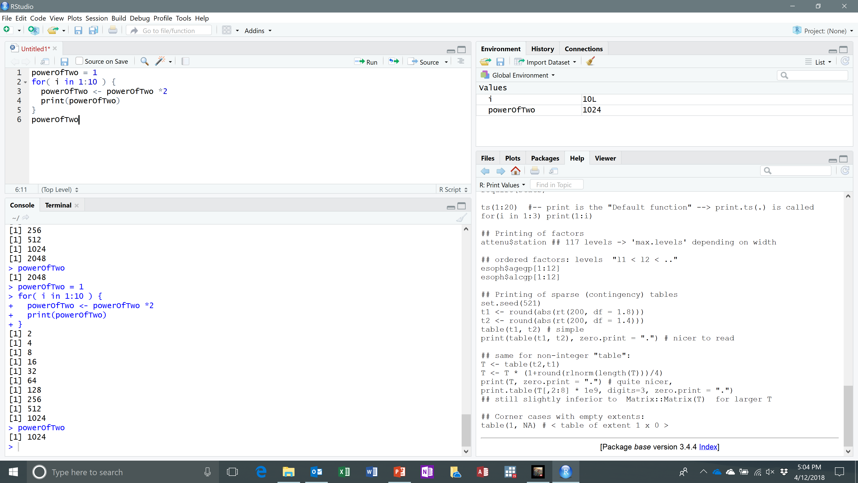
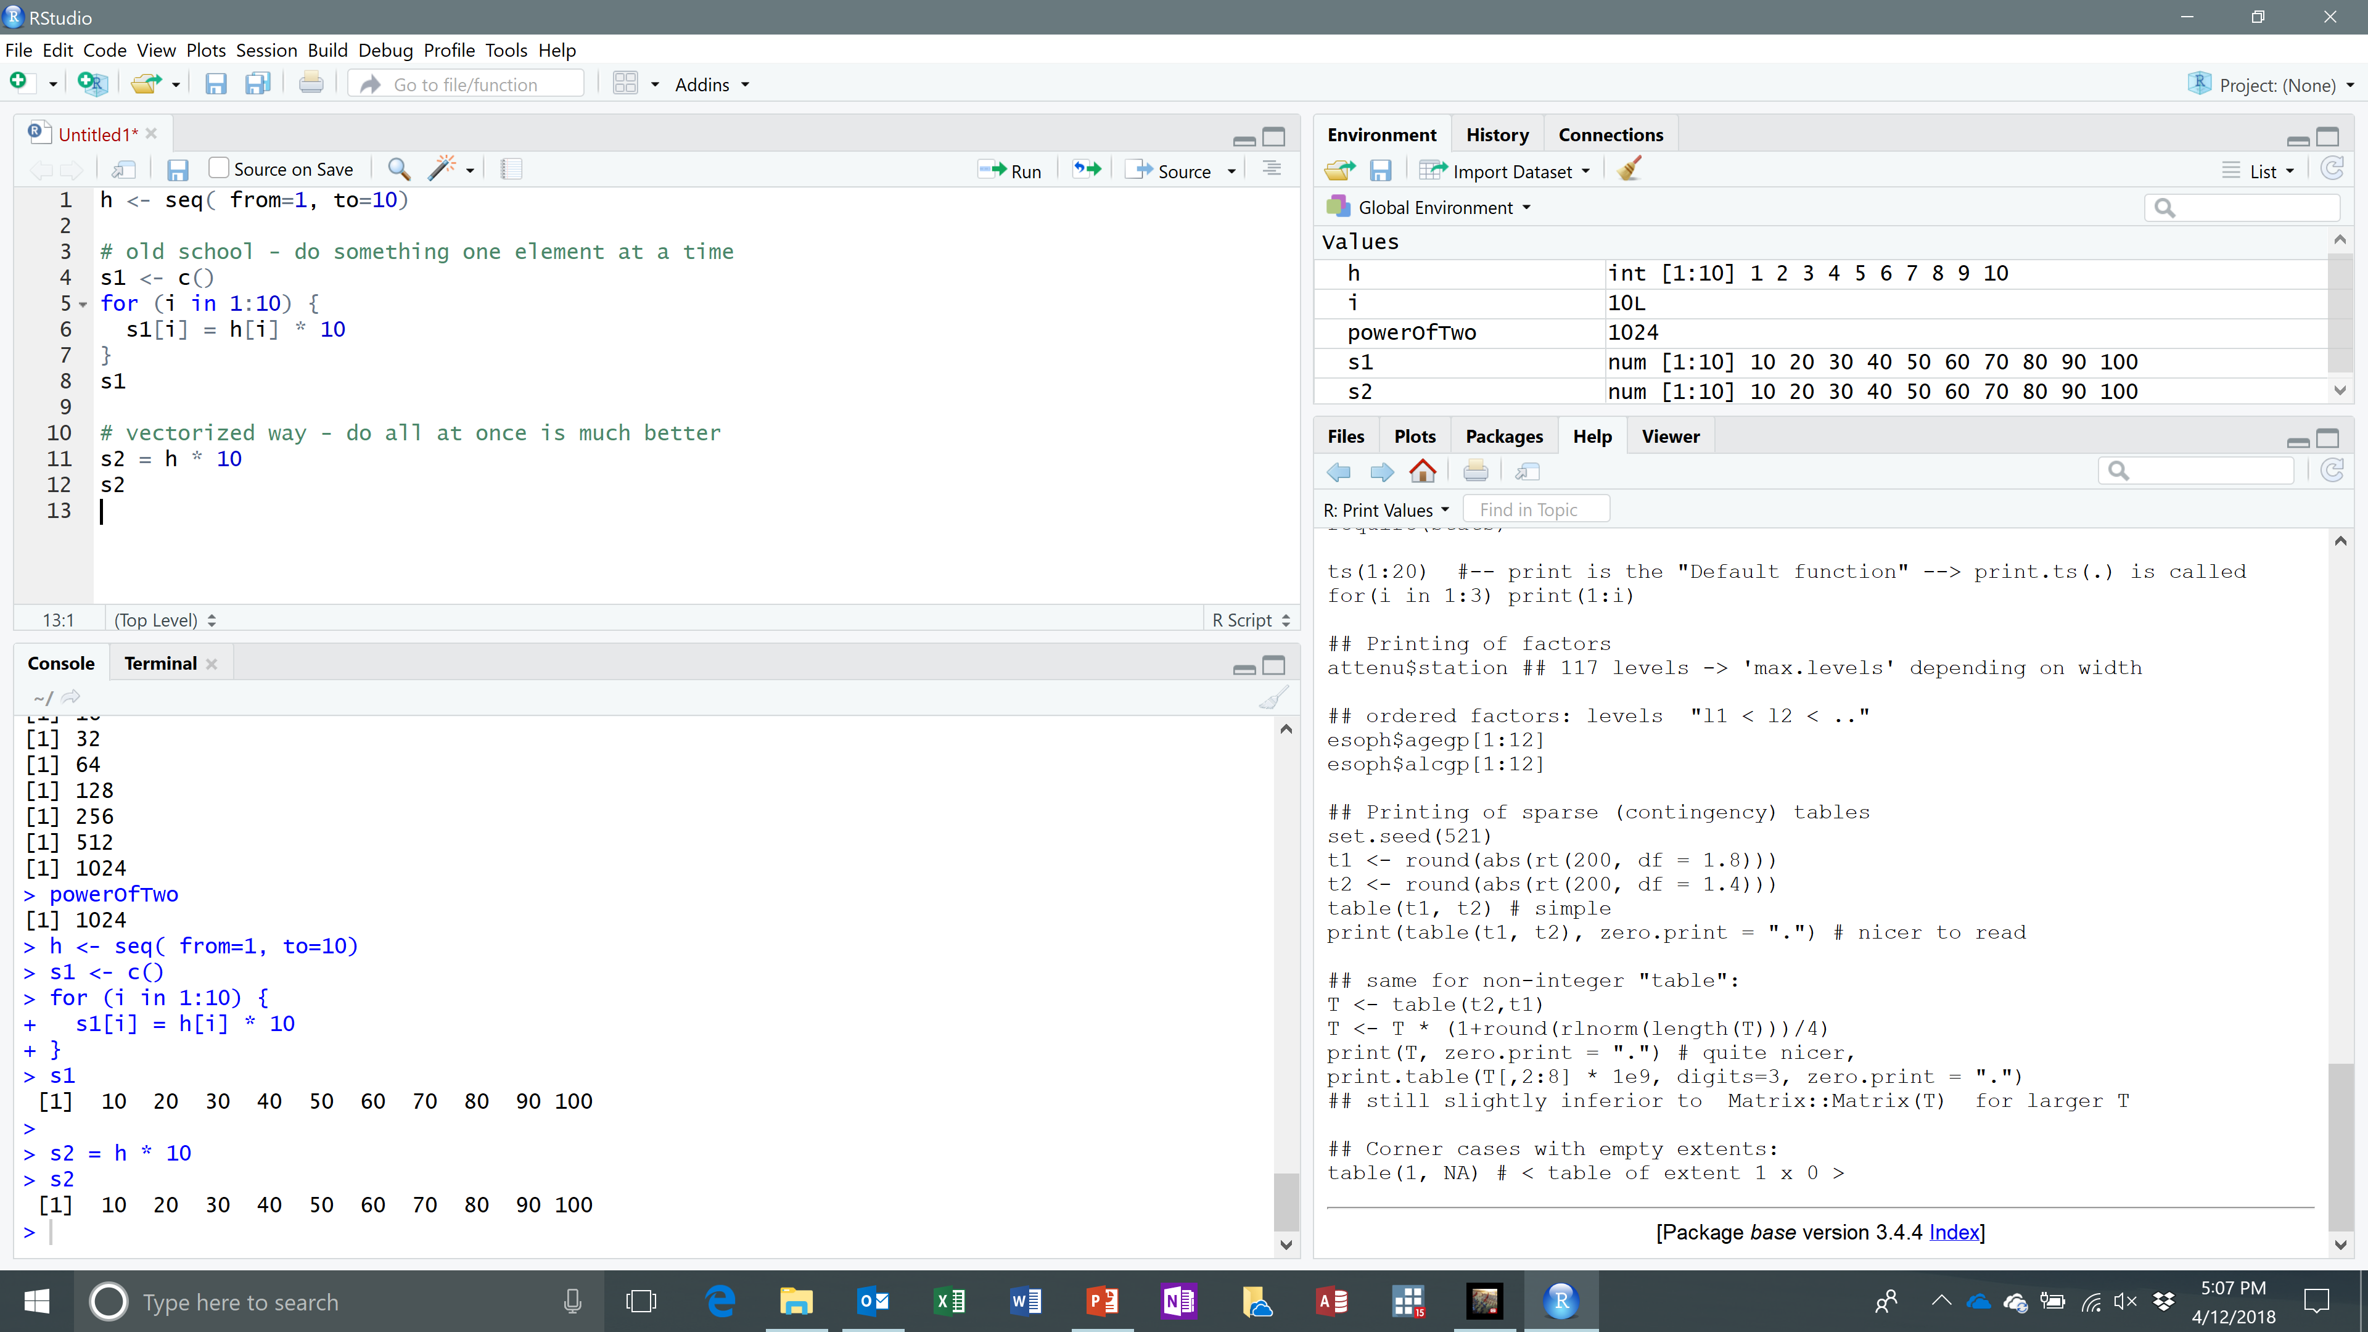
Programming Tools: Looping
Notes:
If you are an old-school C++ or java (or even fortran) programmer like I was, you have some unlearning to do.
In those old programming languages, you have to do operations element by element. This is can be tricky because you
Need to keep track of the number of elements to do this properly.
Sources: See page 10 of Torfs & Brauer

Slide 57
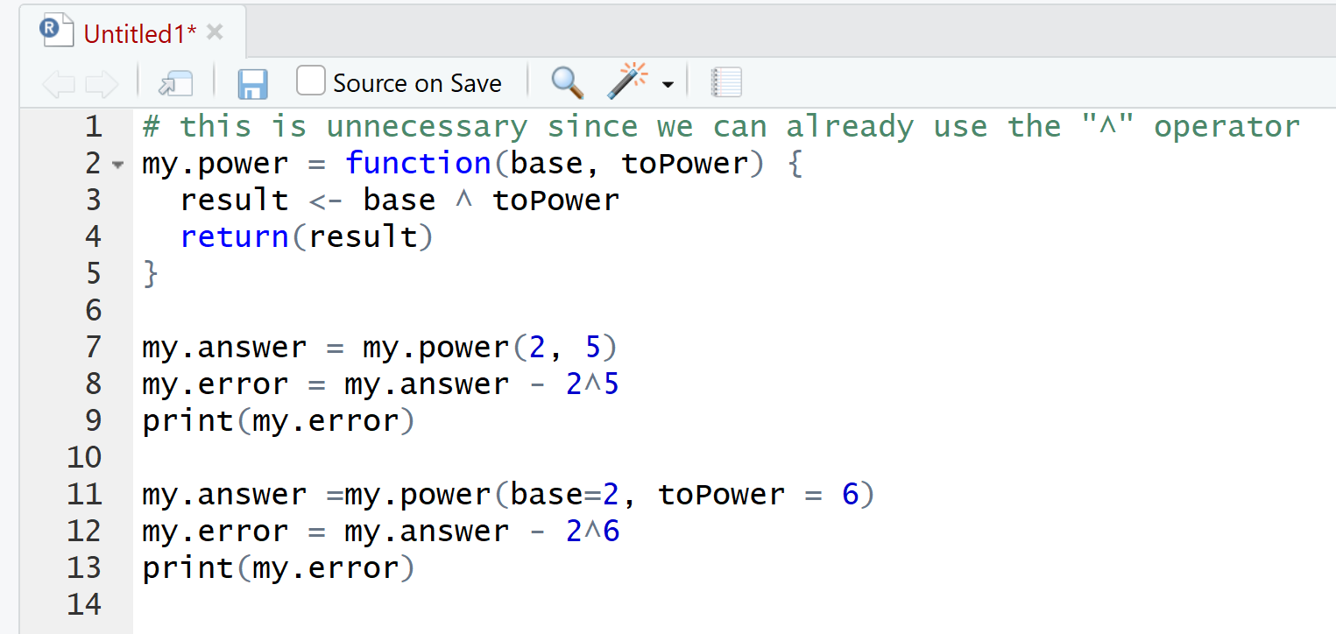
Programming Tools: Writing your Own Functions
Notes:
This is not the smartest use of time, but it does show to create your own function.
We start be defining a function name “my.power” and set it to a function with parameters
We then do some operations and return a value.
Sources: See page 10 of Torfs & Brauer

Slide 58
Benefits of Writing Scripts
Reminder on how to perform the task
Allows rapid iteration
Reduces human error
Allows others to rerun and reproduce your work
Notes:
Sources: See page 9 of Dixon’s Introduction to RStudio

Slide 59
Saving Your Work
Script (*.R)
Workspace (*.Rdata)
History (*.Rhistory)
Notes:
Sources: See page 9 of Dixon’s Introduction to RStudio

Slide 60
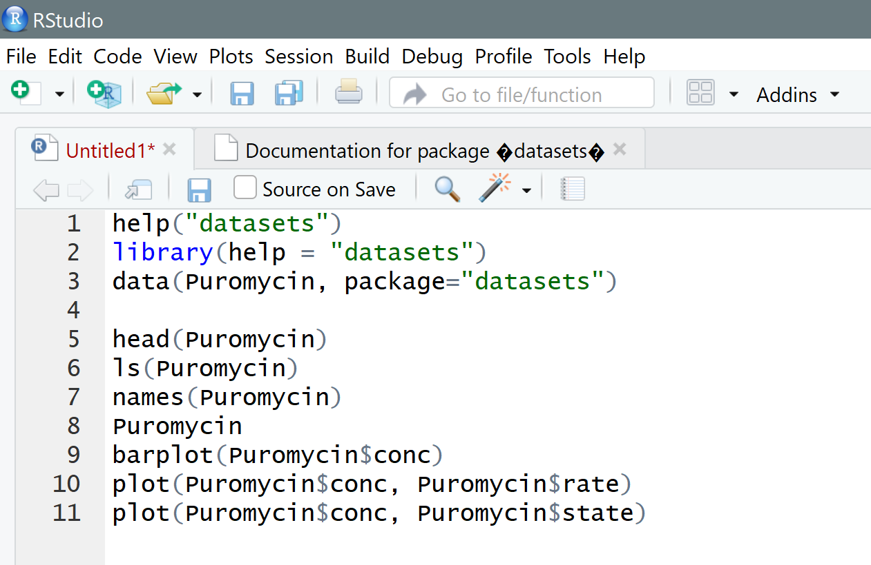
Built in Datasets
Handy when you want to test functionality and don’t feel like making up data
Examples often use these datasets
Notes:
You can also type in data() to see what datasets are available.
The general form for loading in a dataset is first specify the name, and then what package it is in.
R conveniently provides a good number of datasets just so people can have some samples to play around with.
These datasets are all inside a package called “datasets” and the package is pre-installed for everyone.
Here I’m loading, man I should have picked a word I can pronounce correctly, Pure-oh-my-sin???
Sources: See page 11 of Dixon’s Introduction to RStudio

Slide 61
Where to Go from Here?
CRAN has plenty of PDFs
Real physical book: R Cookbook by Paul Teetor
Formerly iTunesU: Using R for Statistical Analysis (videos)
As with many topics: YouTube and online courses

Slide 62
Further Potential Topics
Keeping track of changes to scripts: git
Essential for team sizes of n+ (where n may be as small as 1)
Much prettier charts: ggplot and ggplot2
These can be presentable to management
Convention & packages for arranging data for analysis: tidyverse
An easy way to create HTML with R: Rmarkdown
Interactive web apps: Shiny
And much, much more

